Slide 1
JUSTIN BIEBER
Subject:English
Teacher:Milena Tasić
Authors:Ružica Nenadović
Milica Mašić
Teodora Marinković
Jelena Vujetić
Andjela Vranešević

Slide 2
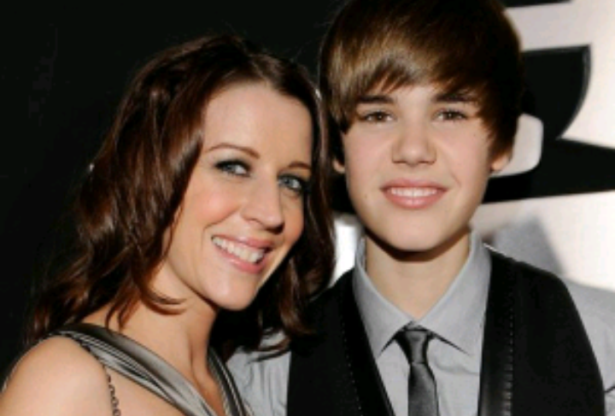
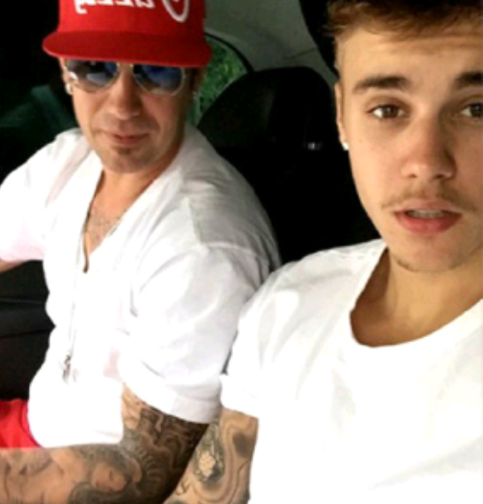
Justin Bieber-biography
Justin Drew Bieber is Canadian singer.Born in 1994.in Ontario,Stratford to a single mother,Bieber took second place in a local talent competition at a young age.He is the only child of Jeremy Jack Bieber and Patricia “Pattie” Mallette.Bieber`s parents were never married.
After a talent manager discovered him through his YouTube videos covering songs in a 2008,and signed to RBMG,Bieber released his debut EP,My World in late,2009.

Slide 3
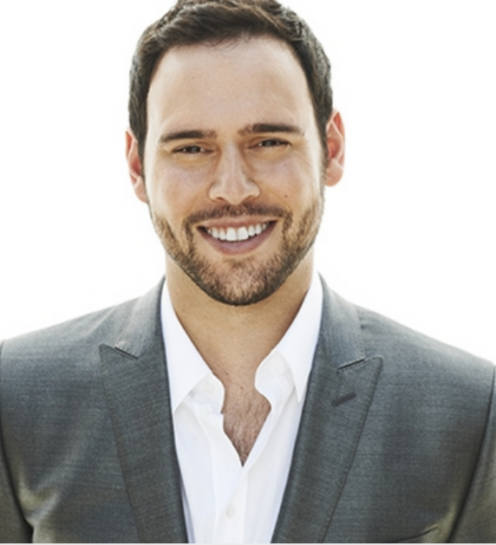
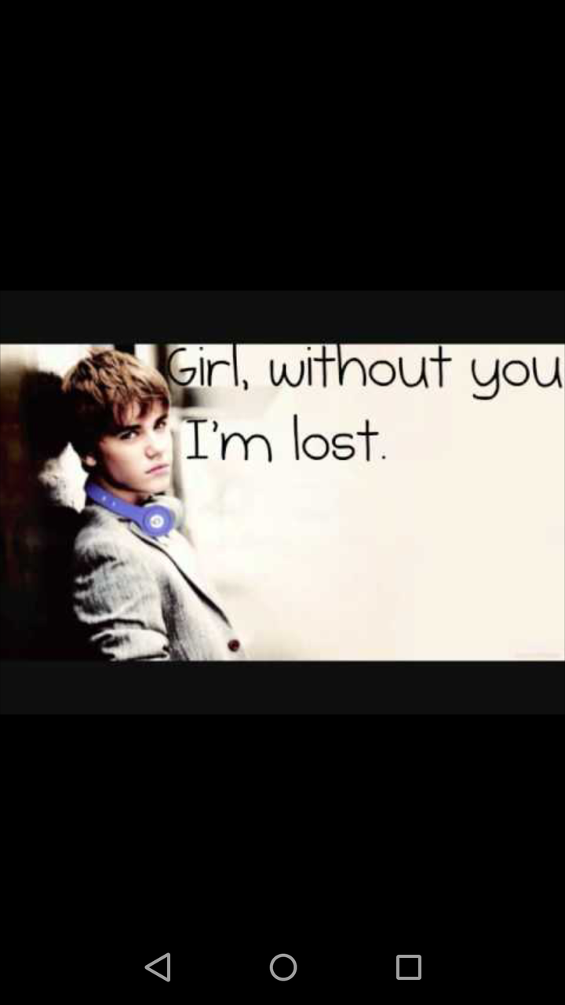
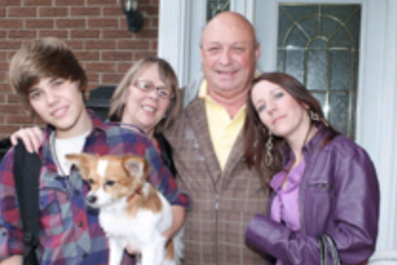
Justin`s beginnings
Looking for young talent,producer Scooter Braun accidentally clicked on his video.After that he contacted his family.He and his mother to Atlanta,to record a couple of demo recordings.Soon the Bieber gets to know the Usher.With the help of Usher Bieber signs the contact for a record house.Bieber moved with his mother to Atlanta to start career there.And he recorded the first song.

Slide 4
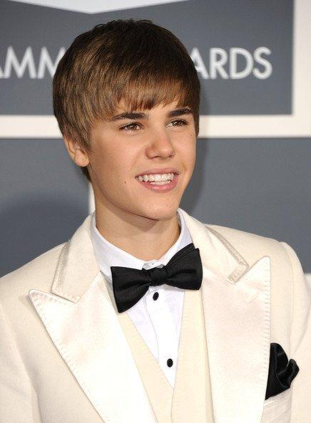
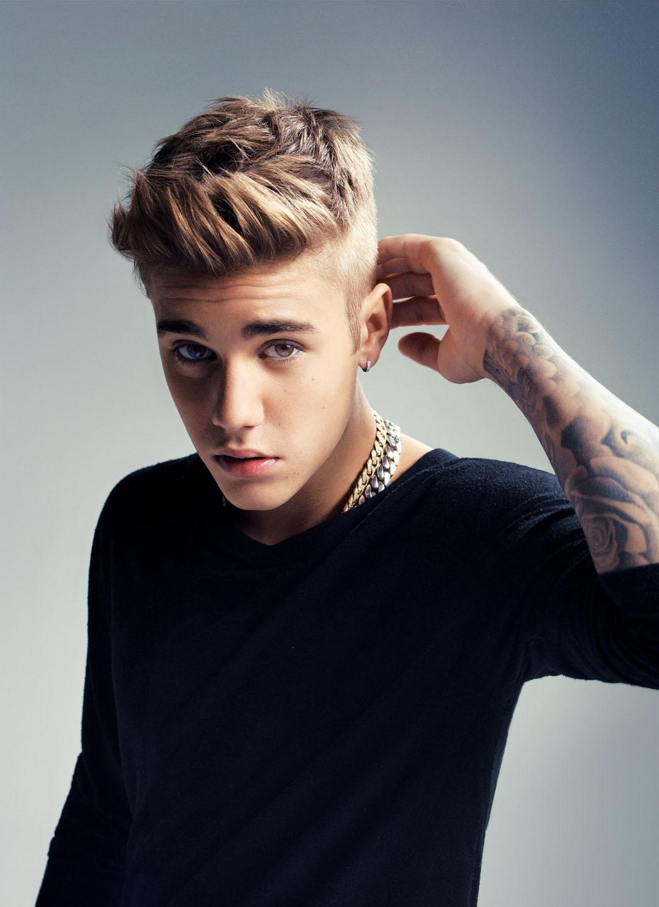
Justin attended the Catholic Primary School “Jeanne Sauve”.
In 2012 he graduated from high school.
His mother was struggling with job and money,she worked jobs that were poorly paid and she raised her son as a single mother.
They couldn’t afford much,but they had a small house and each other.

Slide 5
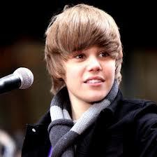
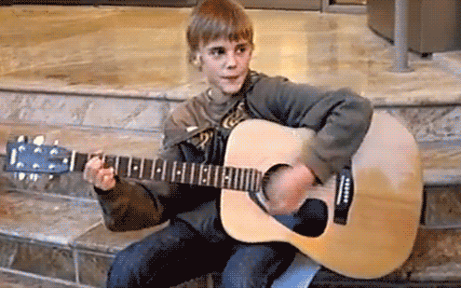
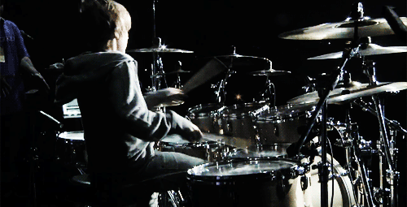
Justin always loved music,he always had a passion for singing and playing instruments like drums,guitar and piano. In 2007 he participated in a local music competition,performed the ‘So sick’ score and won the second place.
His mom recorded his singing and put it on YouTube so friends and relatives can see. She continued to apply them,so Bieber’s popularity grew on this site.

Slide 6
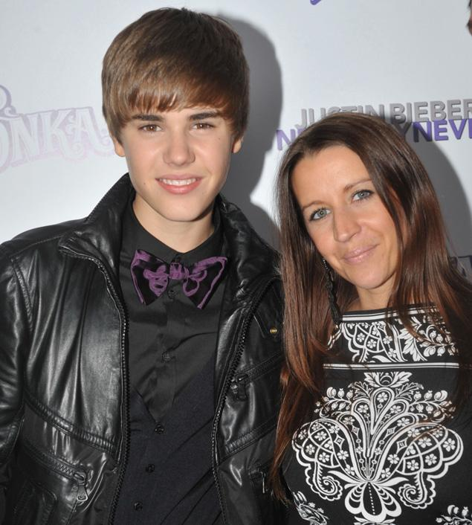
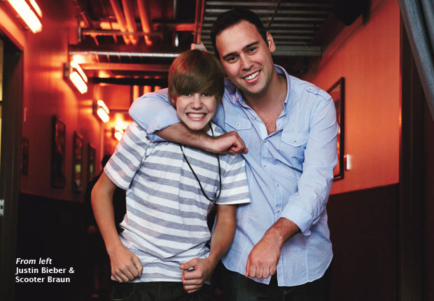
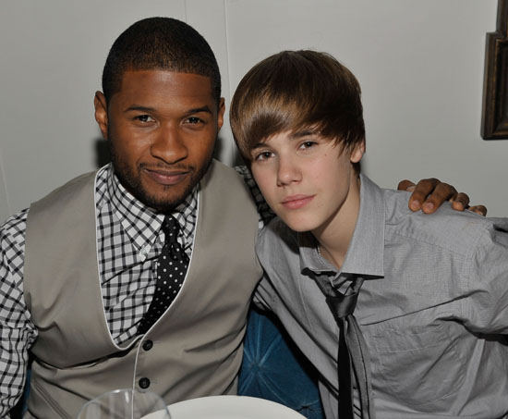
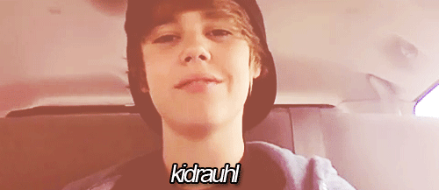
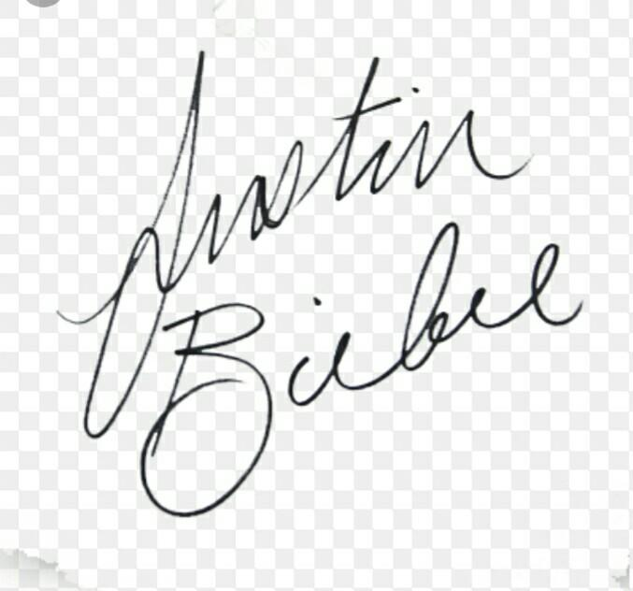
That’s how it was noticed by Scooter Brown’s talent manager.He was impressed by the singer and called his mother.
She initially opposed their cooperation because Scoter was Jewish.However,Church elders convinced her to let Bieber go with him. At the age of 13,he arrived in Atlanta where he recorded demo recording.A week later he began singing for Usher.
And so his career began.

Slide 7
Beginning of his career
He became famous worldwide after posting a viral video with a song of his composition one time on YouTube.
He is recognized as one of the youngest and highest paid performers in music industry .
In 2007,12 year-old Justin took part in local talent contest called-Stratford idoc.He sang Ne-yo’s song so sick and won the second prize.

Slide 8
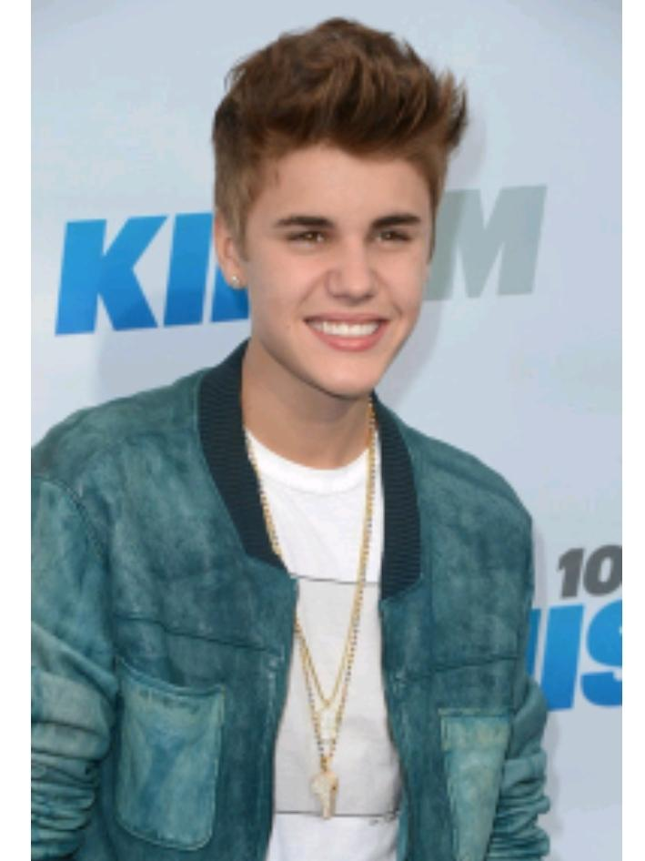
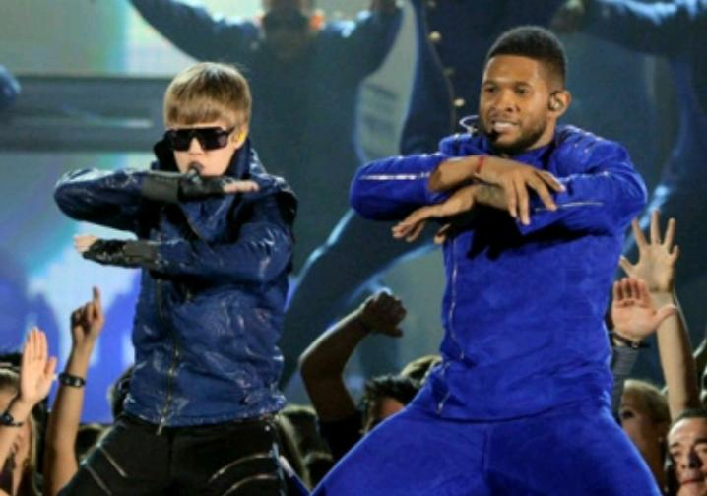

Slide 9
First single
In 2009 the singer posted his first singe One time video.
The video blew up the youTube and hade more then a million views.
Fameous rapper Usher was so impressed that he decided to offer collaburation to the young man.
Biber chose to be quided by the rapper and signed contract with him in 2008

Slide 10
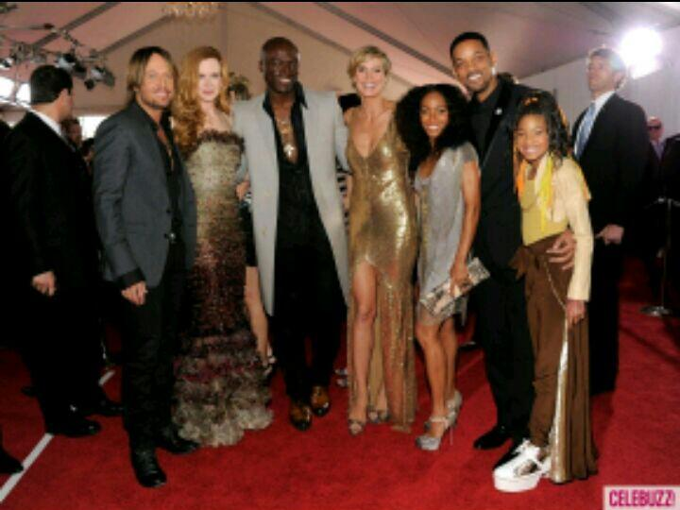
Justin Bieber:Now
Justin Bieber,along with Quavo,Chance the Rapper,and Lil Wayne provided vocals on DJ Khaled’s single” I’m the One”,released on April 28,2018. The song reached number 1 on the Billboard Hot 100. One week later, Despasito topped the charts in the U.S. ,making the single the first mostly Spanish-language Hot 100 No. 1 in more than 20 years becoming his fifth number one single and it made Bieber the first artist ever to notch new No. 1s in back-to-back weeks. On June 9,2017 French DJ David Guetta’s single “2U”,in which Bieber was featured,was released. The music video to “2U” is Victoria’s Secret models lip synching to the song.

Slide 11
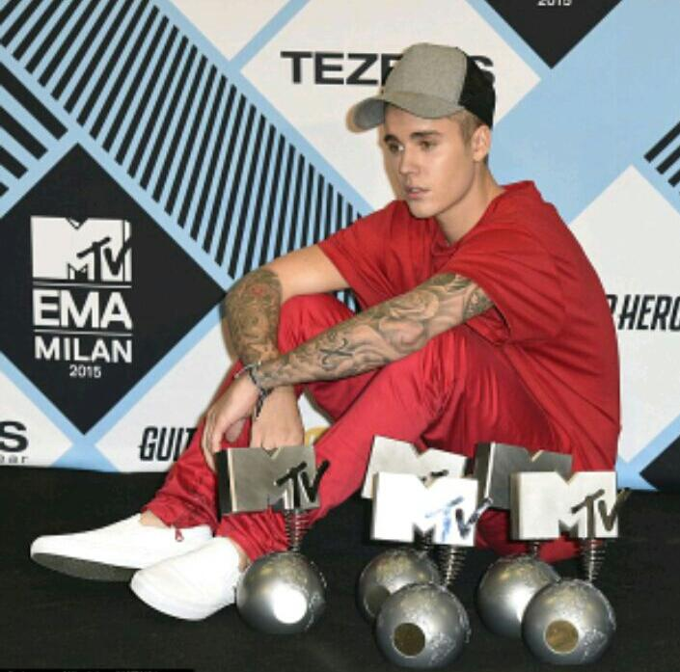
On August 17,2017,Bieber released the single “Friends” with American record producer and song write Blod Pop. Song writers Julia Michaels and Justin Tranter reunited with Bieber to construct the song,just as they helped create his single “Sorry” in 2015 on his studio album Purpose. Bieber did not attend the 2018 Grammy Awards Show to perform the nominated song “Despacito”, claiming that he would not make any award show appearance until his next album was finished.

Slide 12
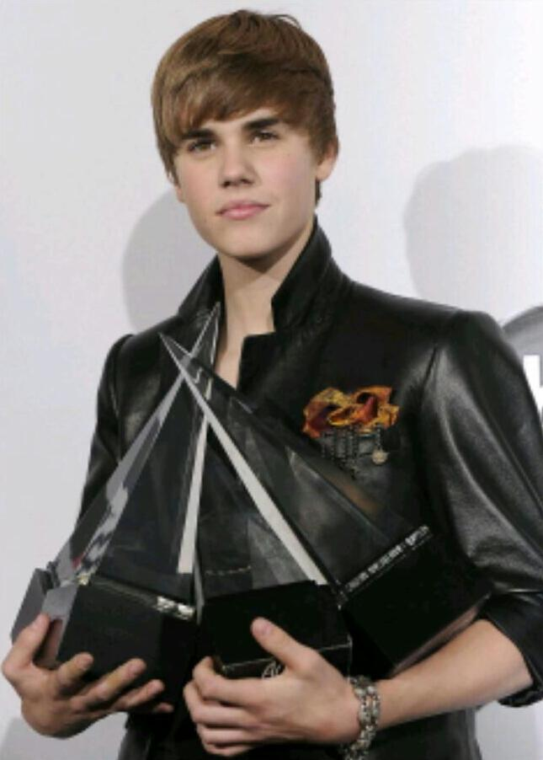
Justin Bieber: Awards
On November 23,2012,Bieber was presented with the Queen Elizabeth || Diamond Jubilee Medal by the Prime Minister of Canada, Stephen Harper. He was one of 60,000 Canadians to receive the Diamond Jubilee medal that year. In 2013,Bieber received a Diamond award,from the Recording Industry Association of America (RIAA) to recognize his single “Baby” as the highest-certified digital song of all time Bieber has earned tem Grammy nominations,two Brit awards,four NRJ Music awards nominations thirteen Billboard Music Awards and numerous fan voted accolades which include eight American Music Awards,and twenty Teen Choice Awards. He also has won eighteen,MTV Europe Music Awards,which is the most awards received by a single artist to date.

