Slide 1
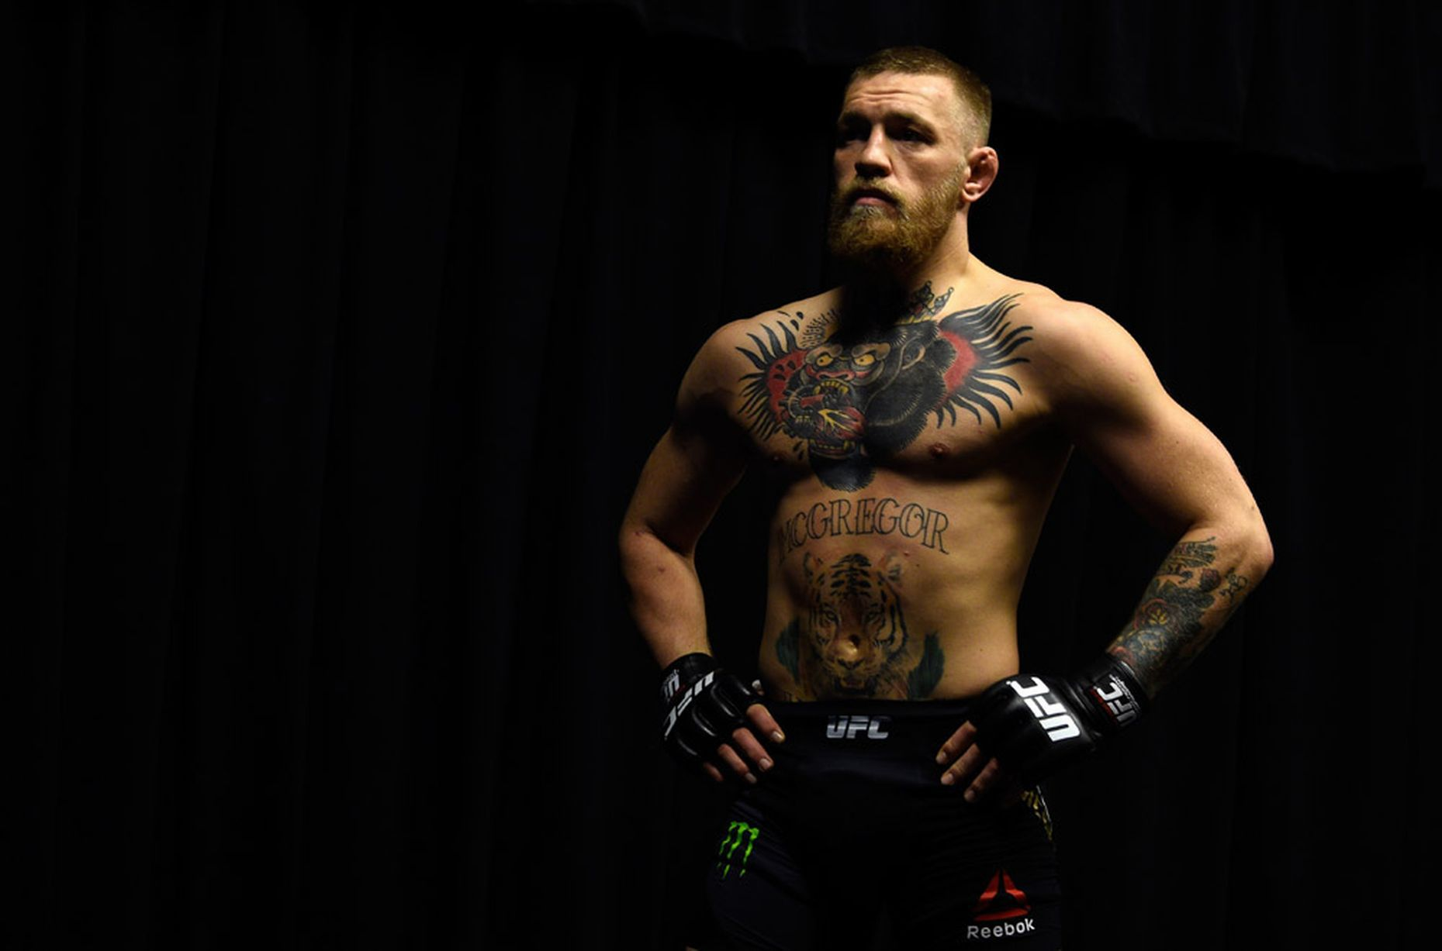
Conor McGregor
Subject: English
Teacher: Milena Tasić
Authors:Božić Sanja
Ilijevski Mina
Novičić Kosta
Pavlović Luka
Radojčić Marko

Slide 2
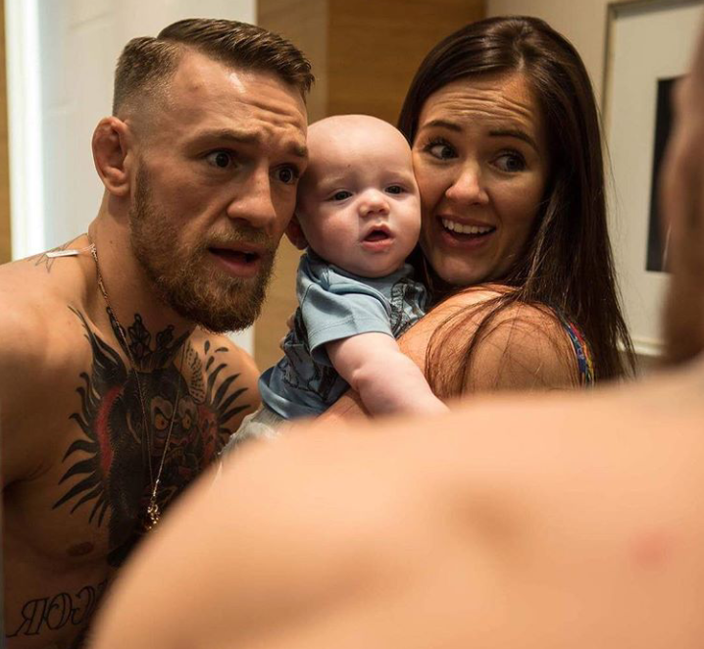
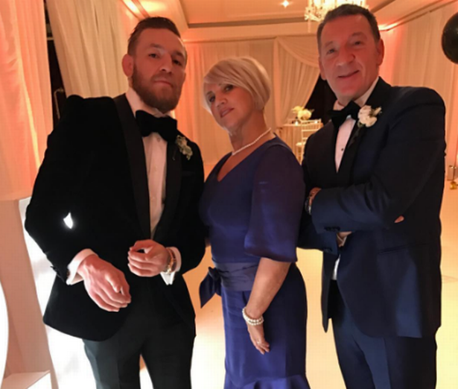
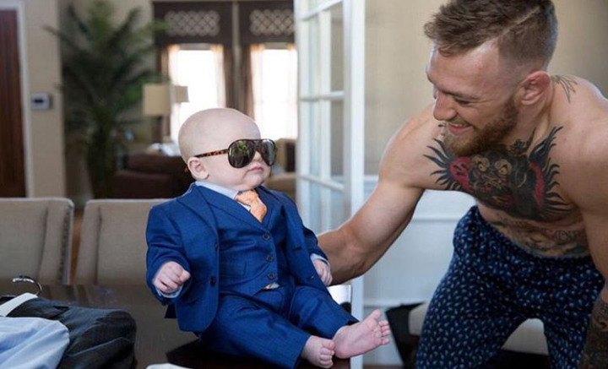
Conor McGregor biography
Conor Anthony McGregor was born on 14 July 1988 in Crumlin, Dublin, the son of Tony and Margaret McGregor.At the age of 12, McGregor also began boxing at Crumlin Boxing Club.
In 2006, McGregor moved with his family to Lucan, Dublin, attending Gaelcholáiste Coláiste Cois Life. Following that, he commenced a plumbing apprenticeship.While in Lucan, he met future UFC fighter Tom Egan and they soon started training mixed martial arts (MMA) together.
He is father of children Conor Jack McGregorJr.

Slide 3
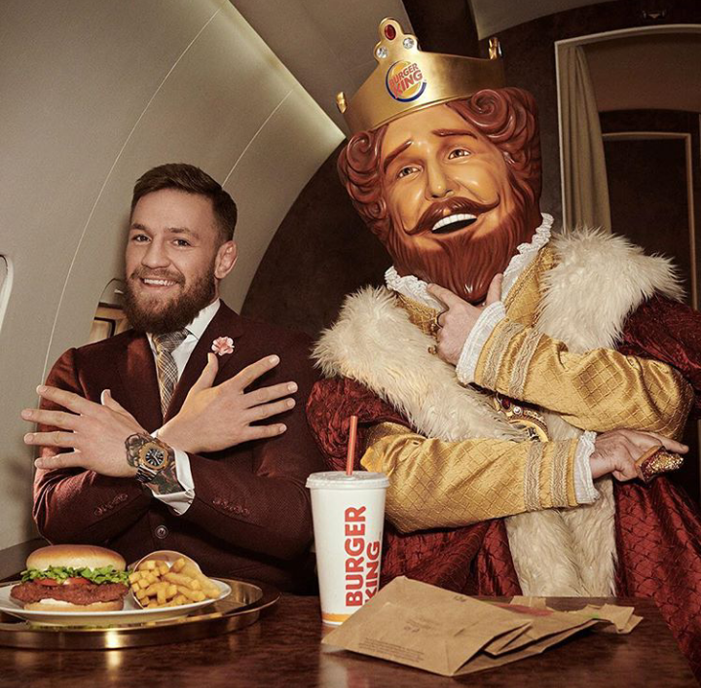
Fun fact:
McGregor often trains at the Mjölnir gym in Reykjavik, alongside fellow UFC fighter Gunnar Nelson.
He has stated that he does not adhere to any pre-fight rituals or superstitions because he believes them to be "a form of fear"
On 20 September 2017, Congressman Markwayne Mullin said that McGregor would be addressing the United States Congress about legal protections for MMA fighters. McGregor is thought to be speaking on behalf of extending the Muhammad Ali Boxing Reform Act, which extends the rights of boxers, to MMA.
McGregor has endorsement deals with Beats by Dre, Monster Energy, Reebok and Bud Light His endorsement deals round up to $7 million.In early 2018, McGregor signed a deal with Burger King

Slide 13
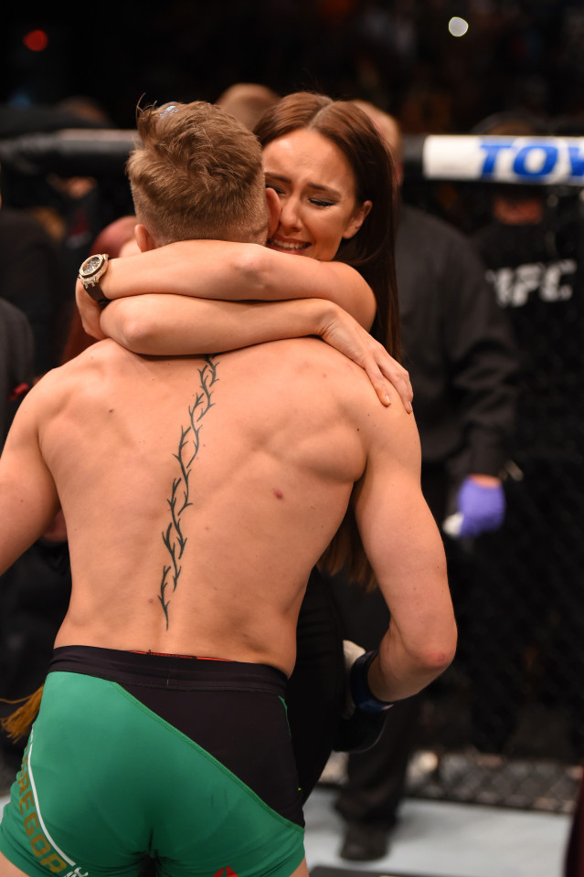
Love story of Conor McGregor and Dee Devlin
Conor McGregor and his girlfriend Dee Devlin met all the way back in 2008 when Conor was just 19 year old man dreaming of becoming a champion MMA fighter.
When they first fell in love, they lived in a small apartment near Dublin. He would talk about how he wanted to be a champion one day but some days were exhausting, some days life his to hard.
On those days Conor would be a wounded warrior. His only relief from the pain wound be Dee’s words “Conor, its okay. You can do it!”

Slide 14
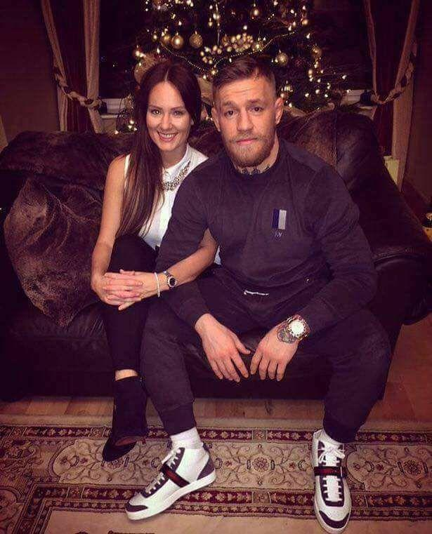
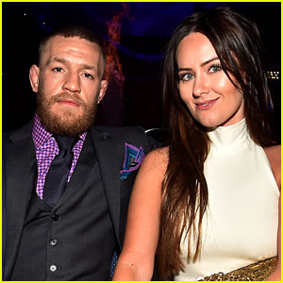
Conor and Dee
She was there with him when he was plumber training to become a fighter. She’s still around when he has become arguably the most famous MMA fighter of all the tiem. The woman behind the warrior, the queen behind her king.

Slide 15
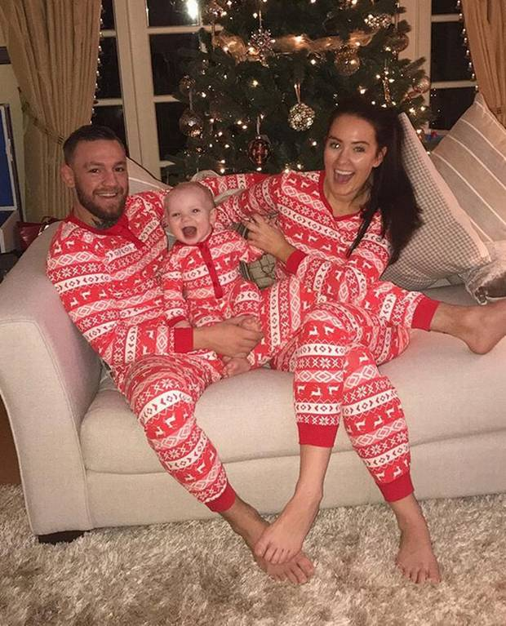
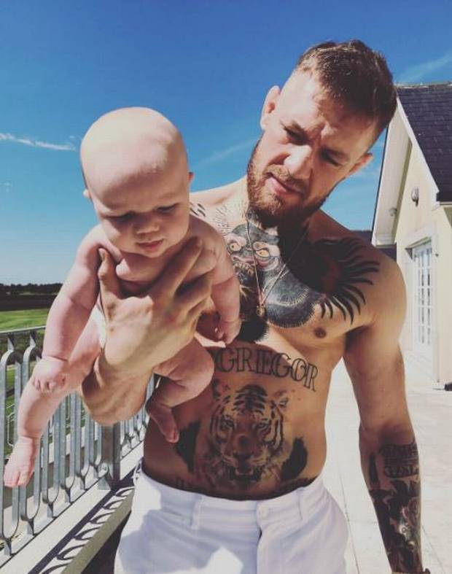
McGregor has been vocal in the past about his appreciation and commitmend to Ms. Devlin, who has supported him from the “absolute nothing” after following his fight against Alvarez, McGregor comfirmed speculation that he will be taking some time off to welcome his first child Conor Jack McGregor Junior with Devlin in 2017. McGregor said he has no intention of bringing his baby up in the fame- driven world.

