Slide 1
Topic: Body and Mind; physicist Stephen Hawking
Authors:
Tamara Rušević
Natalija Rosić
Jovana Stanojević
Valentina Vukelić
Emilija Mićić
Subject:English
Teacher: Milena Tasić

Slide 2
Stephen Hawking
Stephen William Hawking, (born January 8, 1942, Oxford,England—died March 14, 2018, Cambridge),was English theoretical physicist whose theory of exploding black holes drew upon both relativity theory and quantum mechanics. He also worked with space-time singularities.

Slide 3
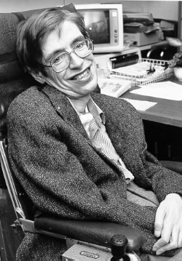
In 1963,Hawking contracted motor neurone disease and was given two years to live,yet he went on to Cambridge to become a brilliant researcher and Professorial Fellow at Gonville and Caius College. Professor Hawking received over a dozen honorary degrees.He was a fellow of the Royal Society and a member of the US National Academy of Science.
Stephen Hawking is regarded as one of the most brilliant theoretical physicists since Einstein.

Slide 4
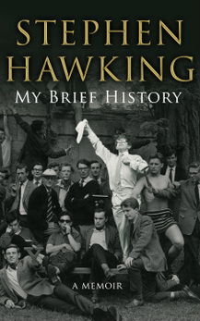
For the first time, Stephen Hawking turned his gaze inward for a revealing look at his own life and intellectual evolution.My Brief History recounts Stephen Hawking’s improbable journey, from his post-war London boyhood to his years of international acclaim and celebrity. Writing with humility and humour, Hawking opens up about the challenges that confronted him following his diagnosis of ALS aged twenty-one. Tracing his development as a thinker, he explains how the prospect of an early death urged him onward through numerous intellectual breakthroughs.

Slide 8
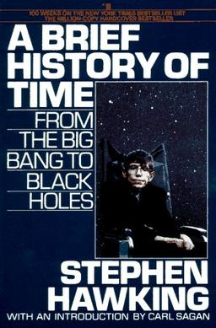
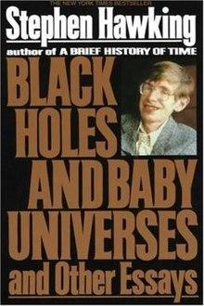
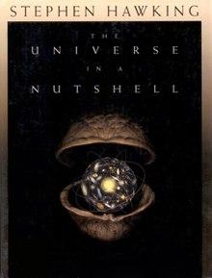
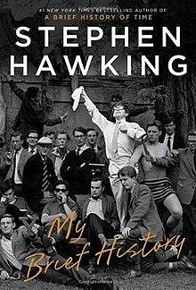
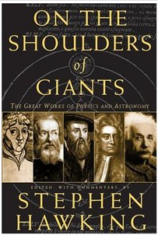
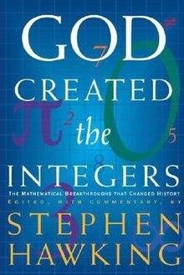
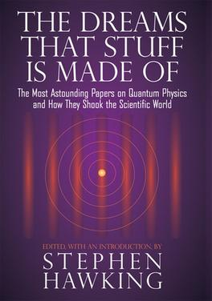
p
Popular books
1. A Brief History of Time (1988)
2. Black Holes and Baby Universes and Other Essays (1993)
3. The Universe in a Nutshell (2001)
4. On the Shoulders of Giants (2002)
5. God Created the Integers: The Mathematical Breakthroughs That Changed History (2005)
6. The Dreams That Stuff Is Made of: The Most Astounding Papers of Quantum Physics and How They Shook the Scientific World (2011)
7. My Brief History (2013)

Slide 9
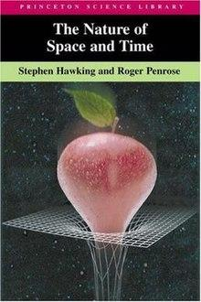
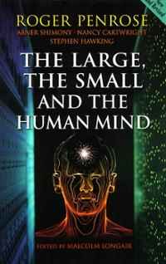
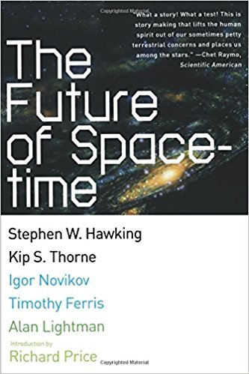
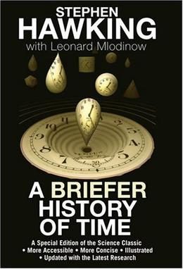
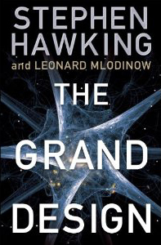
Co- authored
The Nature of Space and Time (with Roger Penrose) (1996)
The Large, the Small and the Human Mind (with Roger Penrose, Abner Shimony and Nancy Cartwright) (1997)
The Future of Spacetime (with Kip Thorne, Igor Novikov, Timothy Ferris and introduction by Alan Lightman, Richard H. Price) (2002)
A Briefer History of Time (with Leonard Mlodinow) (2005)
The Grand Design (with Leonard Mlodinow) (2010)

Slide 10
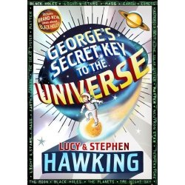
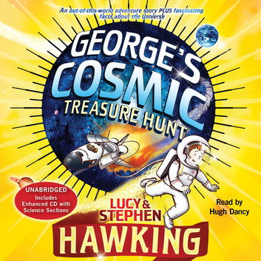
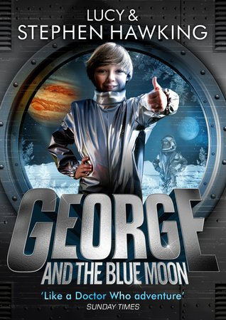
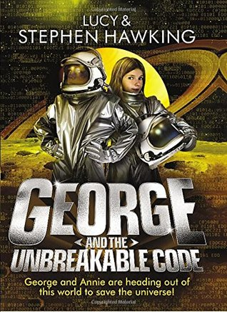
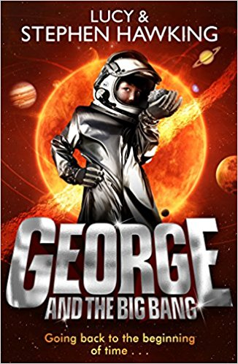
Children's fiction
Co-written with his daughter Lucy.
George's Secret Key to the Universe (2007)
George's Cosmic Treasure Hunt (2009)
George and the Big Bang (2011)
George and the Unbreakable Code (2014)
George and the Blue Moon (2016)

Slide 14
Death
Hawking died in his home in Cambridge, England, early in the morning of 14 March 2018, at the age of 76. His family stated that he "died peacefully".
The Gonville and Caius College flag flew at half-mast and a book of condolences was signed by students and visitors.
His final words to the world appear posthumously, in April 2018, in the form of a Smithsonian TV Channel documentary entitled, Leaving Earth: Or How to Colonize a Planet.
His private funeral took place at 2 pm on the afternoon of 31 March 2018, at Great St Mary's Church, Cambridge. Following his cremation, his ashes will be interred in Westminster Abbey on 15 June 2018 during a Thanksgiving service. His ashes will be interred in the Abbey's nave, next to the grave of Sir Isaac Newton and near that of Charles Darwin.

Slide 15
Personal views
In 2006, Hawking posed an open question on the Internet: "In a world that is in chaos politically, socially and environmentally, how can the human race sustain another 100 years?", later clarifying: "I don't know the answer. That is why I asked the question, to get people to think about it, and to be aware of the dangers we now face."
Hawking stated that, given the vastness of the universe, aliens likely exist, but that contact with them should be avoided. In 2010 he said, "If aliens visit us, the outcome would be much as when Columbus landed in America, which didn't turn out well for the Native Americans."
Hawking argued that computer viruses should be considered a new form of life, and stated that "maybe it says something about human nature, that the only form of life we have created so far is purely destructive. Talk about creating life in our own image.

Slide 16
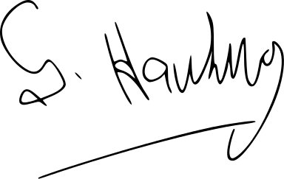
Quote:
Look up at the stars and not down at your feet. Try to make sense of what you see, and wonder about what makes the universe exist. Be curious.
People won't have time for you if you are always angry or complaining.
Intelligence is the ability to adapt to change. -Stephen Hawking

