Slide 1
FOOD AROUND THE WORLD
DIFFERENT CULTURES
Teacher: Milena Tasic
Subject: English
Authors: Milinkovic Aleksandra, Jaksic Teodora, Lekic Ivana, Knezevic Natasa, Adamovic Jovana i Popovic Luka

Slide 2
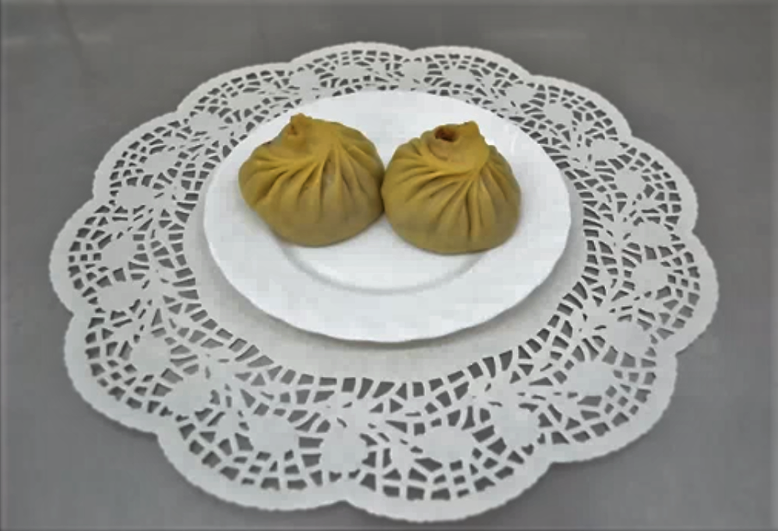
RUSSIA
Russian kitchen is very diverse, and it depends of region and people that lives there. It was created under different influences - history and religion, the way of life, the geographical climate and the crude climate. One of the most popular tradicional meal is Burjatski buzi, made in southeastern Sibir. It is a stuffed dough, filled with mixed meat, black onions and spices, cooked on steam. They eat it with their hands and hot tea or milk is always accompanied by them. Traditionally, they are preparing for holidays.

Slide 3
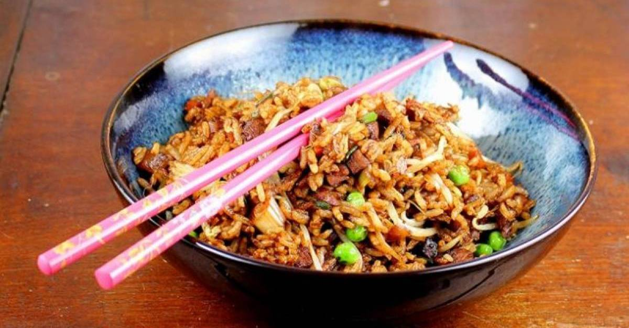
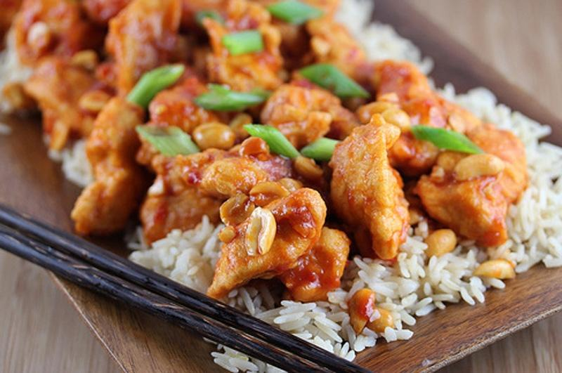
CHINA
Chinese food is one of the most popular food around the world. Rice is the basic ingredient in this type of meal, mixed with vegetables, soy sauce, sweet, neutral or spicy spices. It depends of people taste. You can find Chinese restaurants almost in every country and their food can adapts to everyone. They always drink some tea with their meal, and they eat it with sticks. I can say with certainty that it is great, and you have my recommendation to try it, if you hadn’t already.

Slide 4
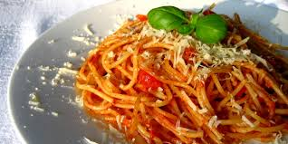
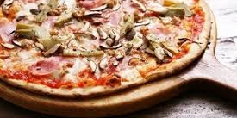
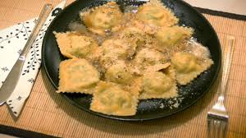
ITALIA
Italian food is another popular food worldwide. Spaghetti and pasta are dominated on Italian table. They adore to eat them with tomato sauce or minced meat. It was named by the name of city; Spaghetti bolognese. Other meals with pasta are favorites, like lasagna. Pizza accomplished big popularity, that big that people across the world are opening restaurants.

Slide 5
MEXICO
Mexican food is all based on corn and mushrooms and different kind of chilli peppers. Regular use of basic corn flour in recipes for meals in mexican kitchen, will not give characteristic tastes of mexican kitchen. Today tortilla in north Mexico are made of wheat flour (esp. Tortilla de harina), because corn don’t grow there that much, but on south Mexico they are made of corn flour (esp. Tortilla de masa).
Mexican food is popular about different tastes and diverse spices.

Slide 6
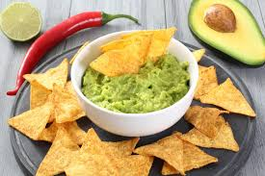
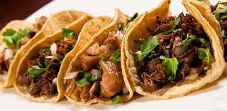
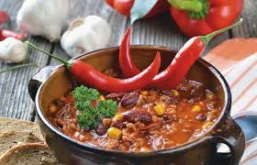

Slide 16
The United Kingdom is an island wcated in the northwestren part of Europe.
Britain’s Romon province was funded after the Romon invasion of Britain in 43 years of a new era.
London was first city tu reach a population of more than one milion in 1811. It remaind tbe largest city in the world until it was overtaken by Tokio in 1957.
The British are trying to clear their channed by combining traditionally and contemporaryly. Uned the great in Flunence of the former colony and the country of their surroundings, their kitchen is a combiration English Cuisine, Mediterranean European oriental cuisine.
For example:
Pumpkin corb
500g pumpkin
1,5l milk
2 lemons
Orange bark
2 cinnamon spoons
4 slices of white bread
1 egg
Butter, they are
Typical meals
Most pubs and locd restaurants offer on English breakfast, combination that has survived century abd is still pretty favorite, especially as a cure for hangover, which is a baked with butter and a bake with a cup of English tea.

Slide 17
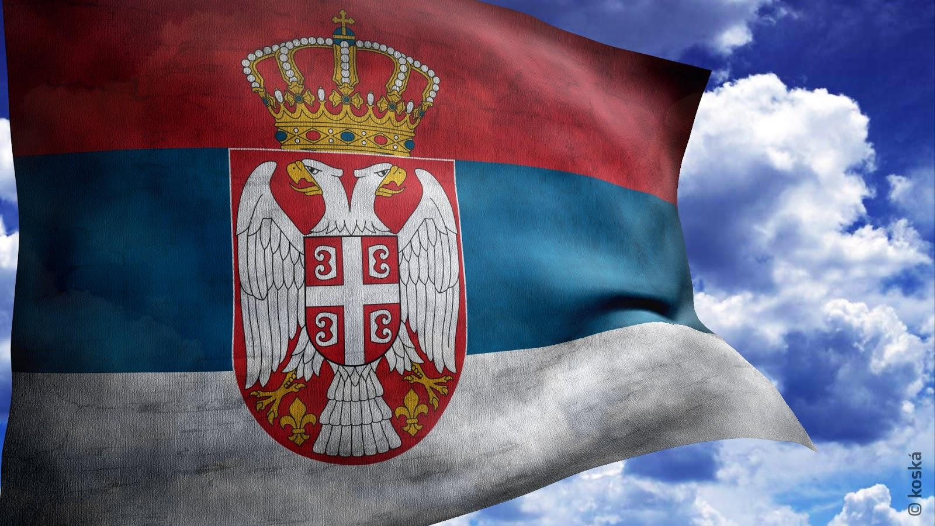
It was founded between 629-632.
Much of it is located on the Balkan Peninsula, and to a lesser extent it occupies the Pannonian Plain.
The Pannonian Plain covers the northern third of the conntry (mainly Vojvodina and Mačva) while the easternmost tip of Serbia extends into the Wallachian Plain. The terrain of centra park of the country, with the region of Šumadija its heart, consists chie fly of hills traversed by the rivers.
The most beavtiful streets of Serbia are located in different parts of the country and completely different from the rest for which tourists are attracted.
Skadarskaya street with Skadarlija is are of the most famous Beom district its auther ticity and narmonious arrangement preserved from past times.

Slide 18
