Slide 1
Relationships subject: English
teacher: Milena Tasić
Sara Polimac, Jovana Kovačević, Nikola Tričković, Andrea Kovačević, Aleksandra Ćuk

Slide 2
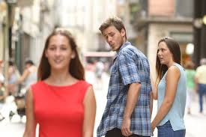
Most people feel a little jealous sometimes, especially when they have strong feelings of attraction and love for their partner, and a little jealousy occasionally can add zest to a relationship.
·Jealousy needs to be controlled.
·Sometimes there is no need for it.

Slide 3
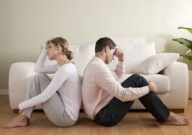
Jealousy—that sickening combination of possessiveness, suspicion, rage, and humiliation—can overtake your mind and threaten your very core as you contemplate your rival.

Slide 4
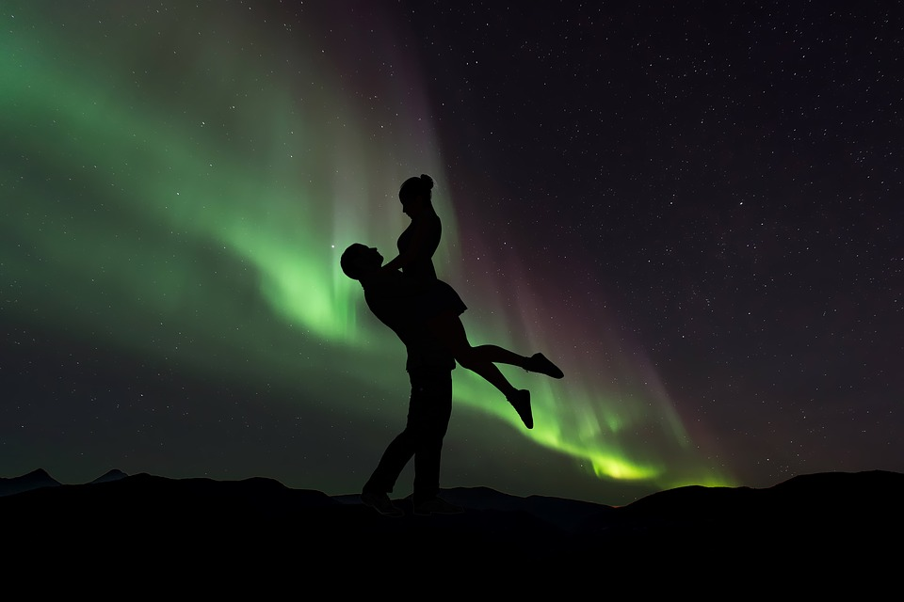
Аs а mаn, the same thoughts about love has woman as well. Woman usually except more love than man. Woman soul is so sophisticated and sensitive. Because of that, them need man attention temporary.

Slide 5
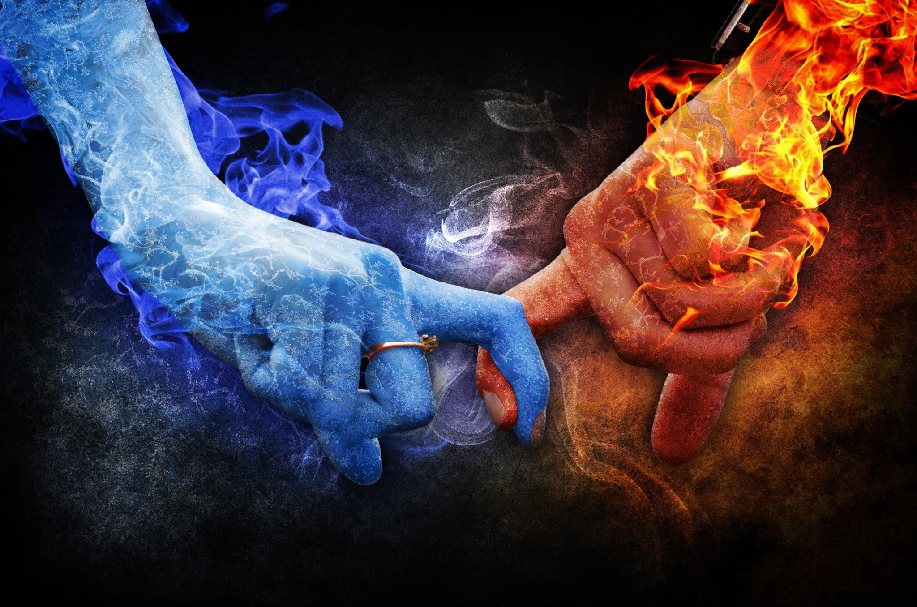
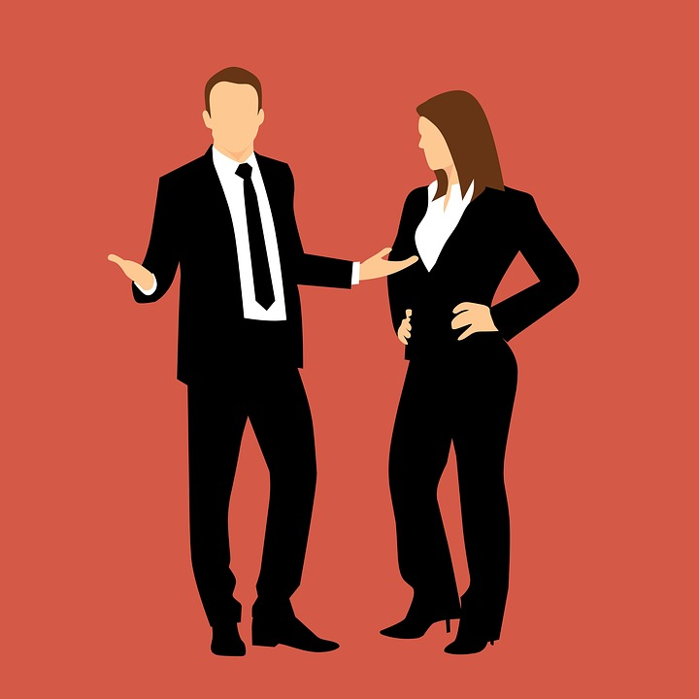
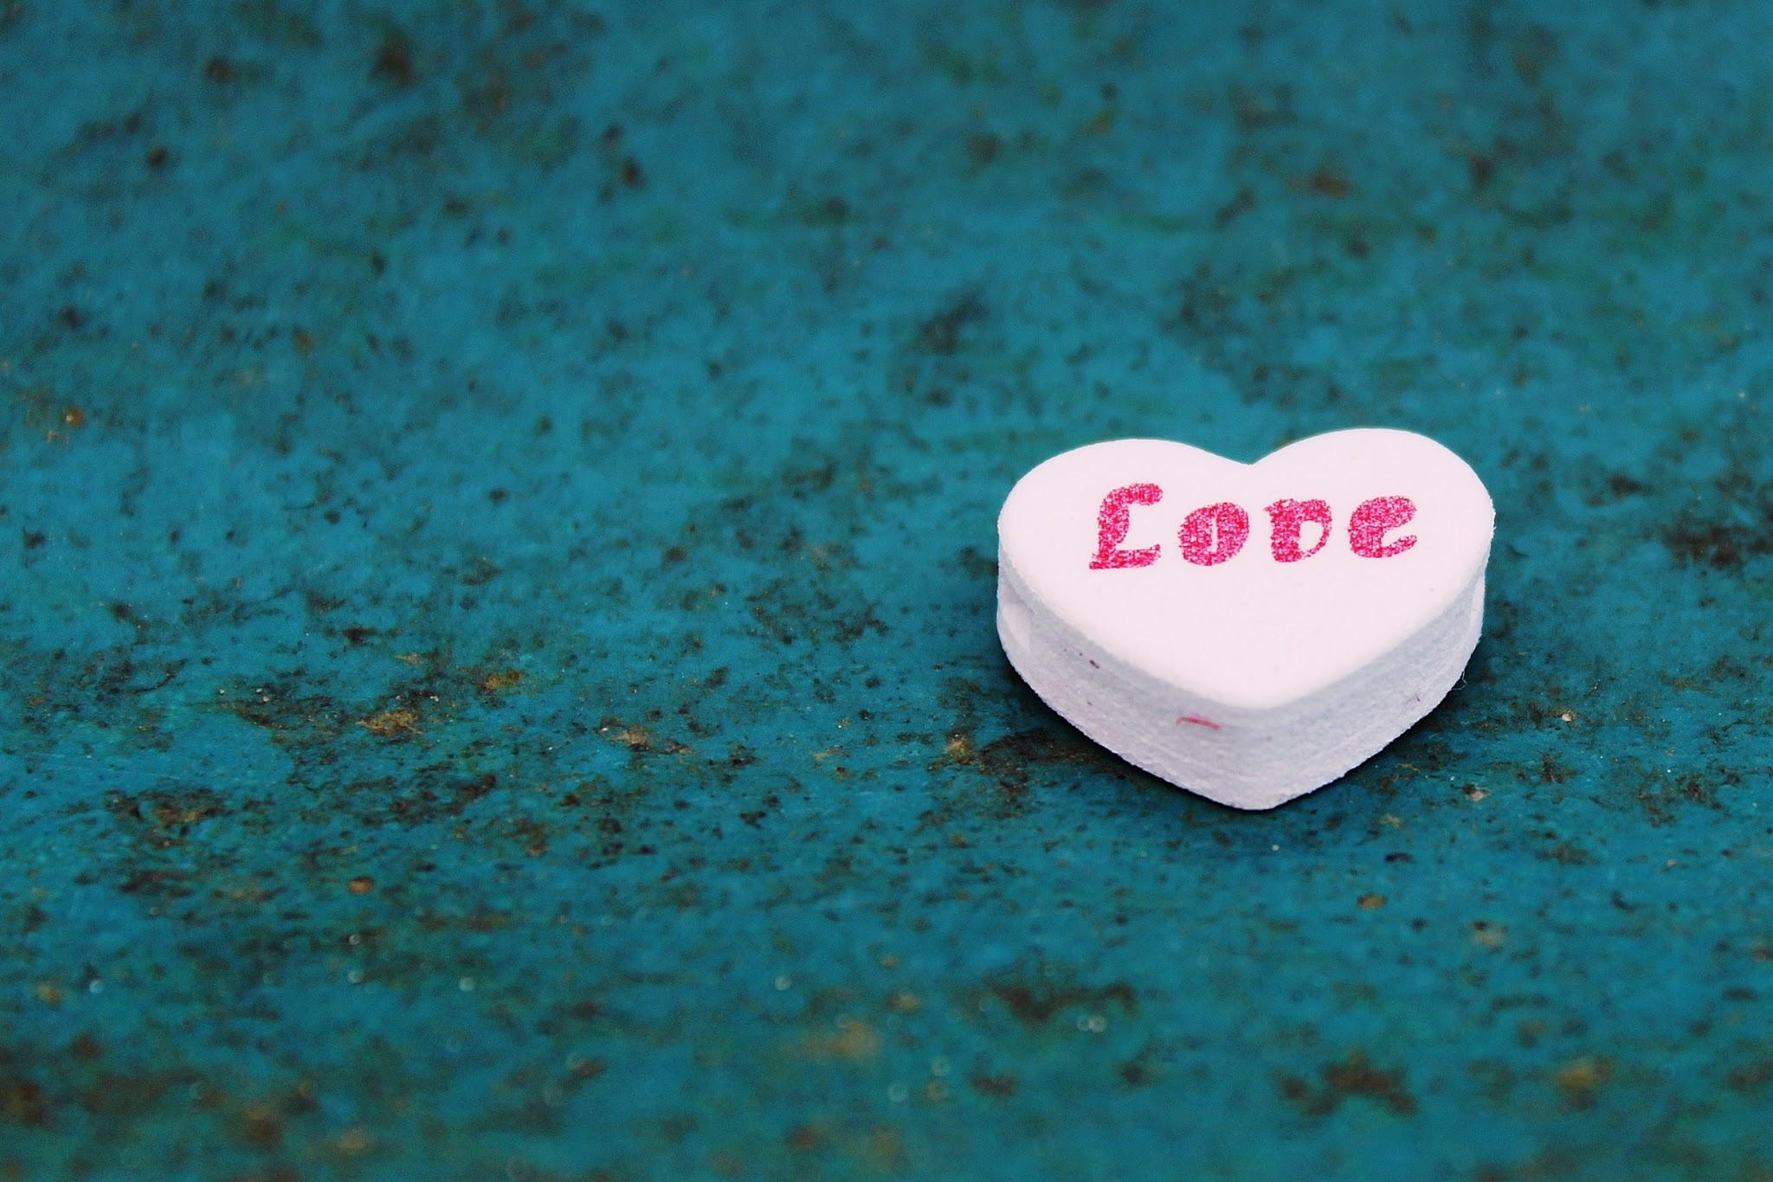
The relationships of some woman might like as a piece of ice. That kind of women is emotional inside themself, but rarely shows that up. Exist the kind of woman whose in the relationships as a fire as well. They say more feelings and jealousy keep a man for themselves only.

Slide 6
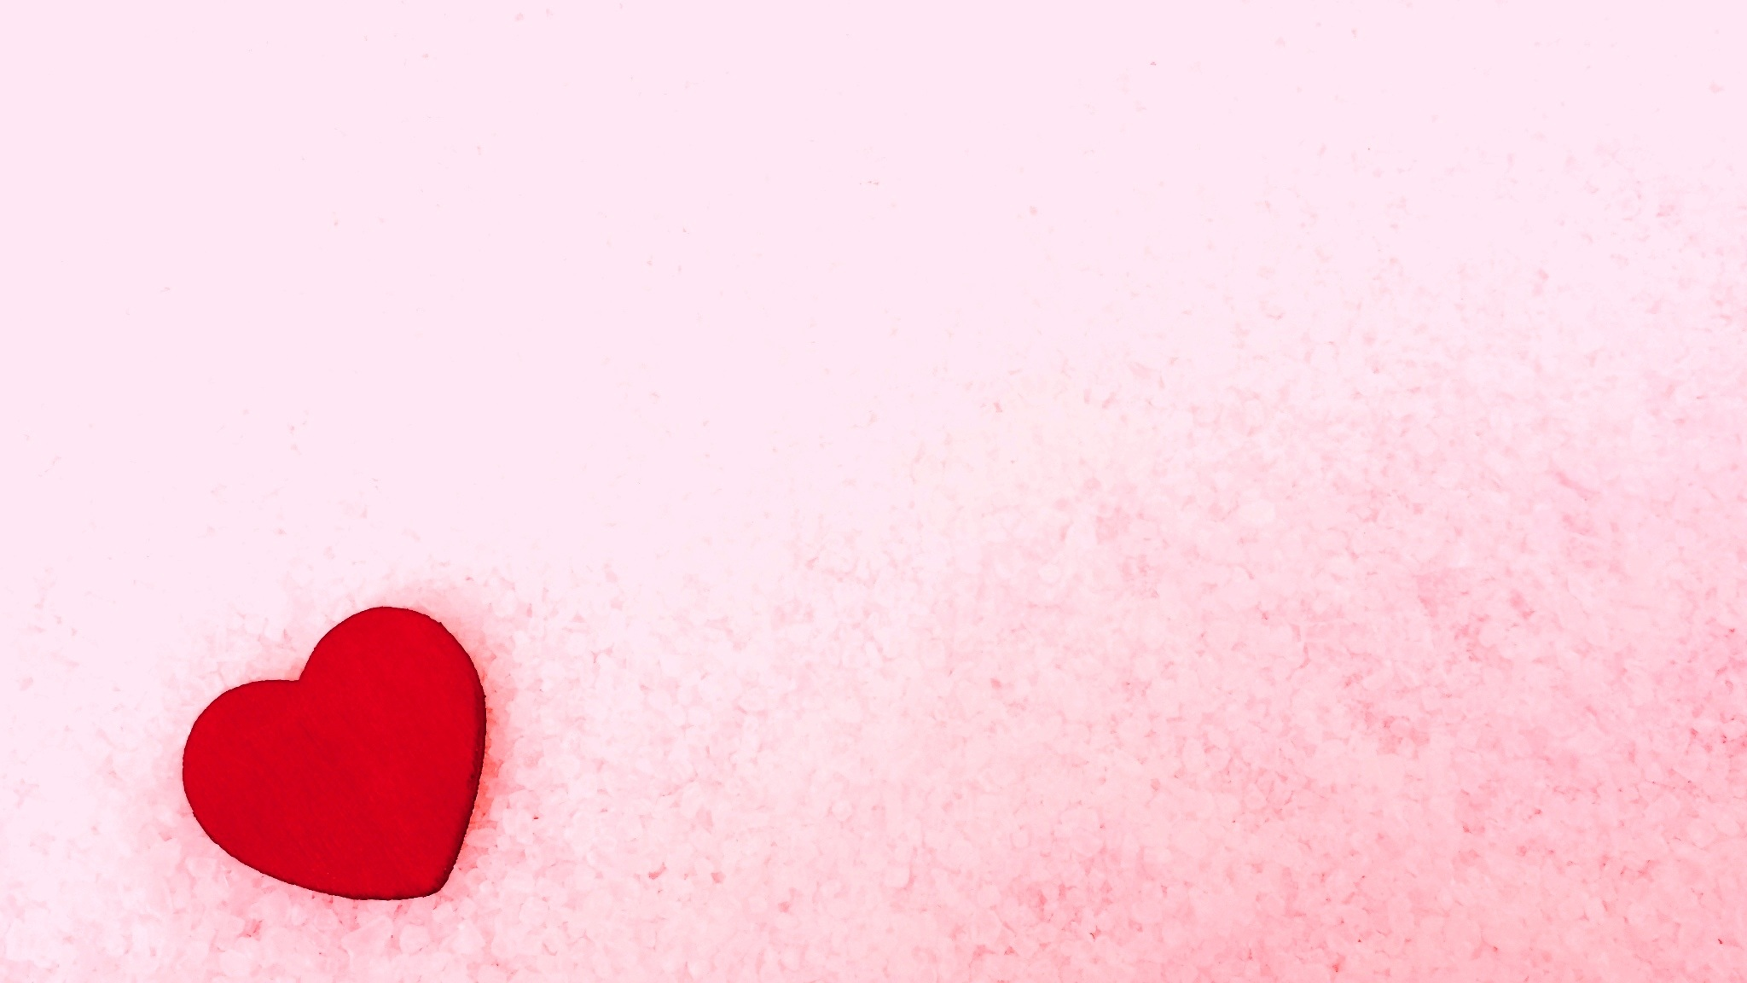
In the relationships woman might be faithful, but unfaithful too. Once founded love lasted forever, those are the thoughts a woman which love is stronger. Some sort of woman depends of lies and intrigues. In the end, every woman in relationship get love, trust and attention which she deserves.

Slide 10
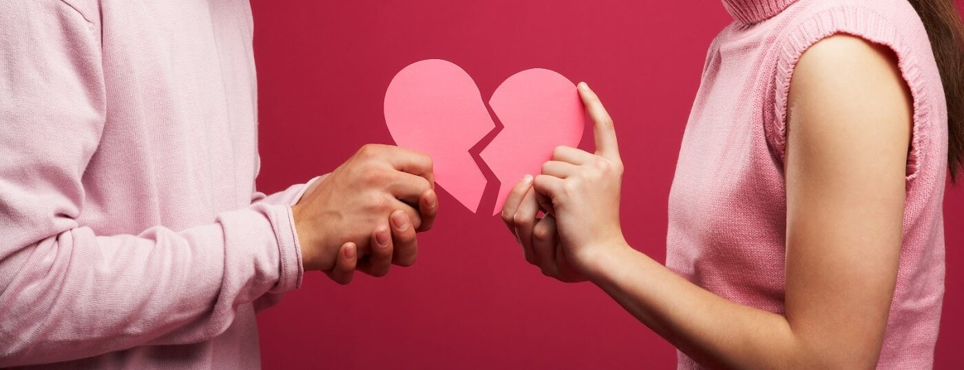
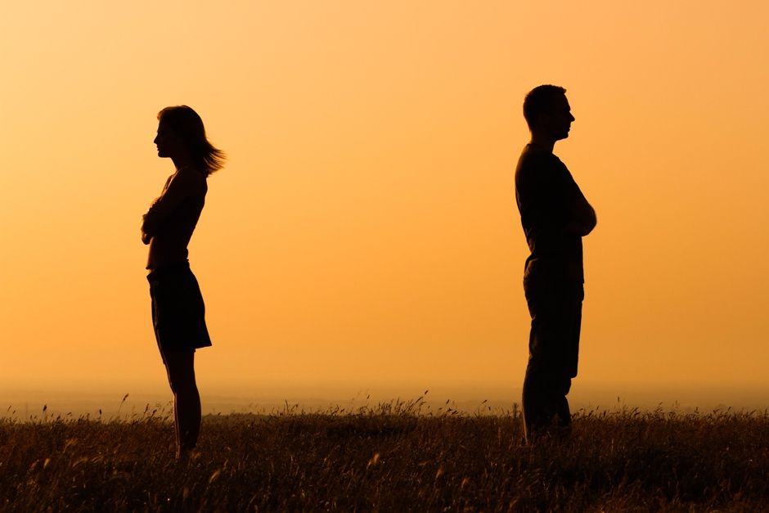
A relationship break up, often referred to simply as a break up is the termination of an intimate relationship.
Most common reasons are: Different values, unreliability, infidelity, abuse and communication issue

Slide 11
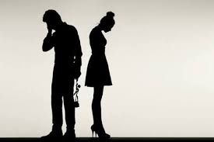
Going through a break up can be very difficult, emotional, and stressful. Whatever is the reason for the split the break up of a relationship can turn whole world upside down and trigger all sorts of emotions like guilt, defeat, fear, anger, shock, exhaustion...

Slide 12
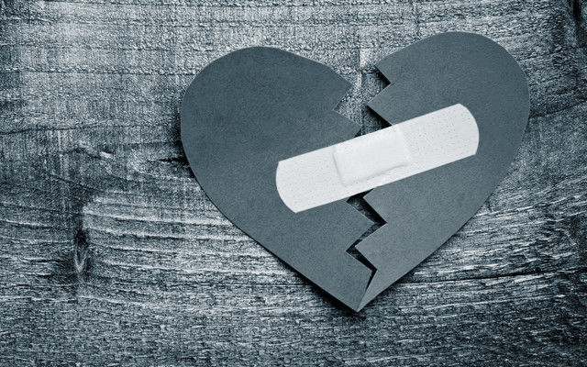
Although break up is both awkward and painful, it allows us a better understanding of how and why relationships fail and helps us learn what works for us and what doesn’t when it comes to relationships.

Slide 13
Most inportant in a relatiships is respect at the end of the day. As hard as it can be we have tu continue on with our lives.

Slide 14
Love is a special thing that connects everybody and we shoud imbrace it as much as we can and make as much relationship as possible in life.

