Slide 2
DEVELOPMENT OF FOOTBALL IN SERBIA
Serbia met football in the spring of 1896. After returning from school in Germany, Hugo Buli, a Jew, brought the first football in Belgrade. Serbia proved to be a fertile ground for a new game and soon, on May 19th, Belgrade citizens saw the first football game.The first ball and the first match conditioned the gathering in clubs on May 1, 1899, the ‘’Trade Cafe’’ held the founding assembly of the first Serbian Ball Association. Feti Bey was elected president and vice-president was Mihailo Zivadinovic. On that day, the foundation for the construction of the serbian ‘’ home of football’’ was laid.

Slide 3
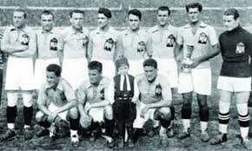
In the spring of 1899, the first football field was built in Hyde Park at Topcidersko brdo, and on May 23 the same year, the first match between two teams of members of the ball.The first football club was founded on 3 May 1901 in Subotica, called the sports athletic club ‘’Backa’’. More than two years later, on September 14, 1903, ‘’Sumadija’’ was born in Kragujevac. After a short time, some other clubs were founded. On September 1, 1911 the Belgrade Sports Club (bsk) was founded. This club dominated the Serbian scene with five titles won by the state and thus became the most profitable and best club of the Kingdom of Yugoslavia.

Slide 4
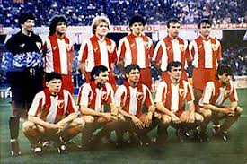
On april 18, 1919, the Yugoslavia football Association was founded in Zagreb. In 1930, 51 clubs were registered in Belgrade, and the Belgrade Ball Association had 91 members. After the discord in the alliance on May 16, 1930, the assembly was convened in Zagreb, and the alliance was given a new name, the Football Federation of Yugoslavia. That same year, the first world championship in Uruguay was held. In this championship, the national team awarded 3rd and 4th place.
After the war, stadiums and playgrounds were rebuilt, and new clubs began to emerge. Thus, on February 25, 1945. Metalac was founded, later renamed to BSK, and then to OFK Belgrade. The same year, marc 4. 1945. The RED STAR was founded, and after 4 october Partizan.
Then many teams were rebuilt and a replay started.

Slide 14
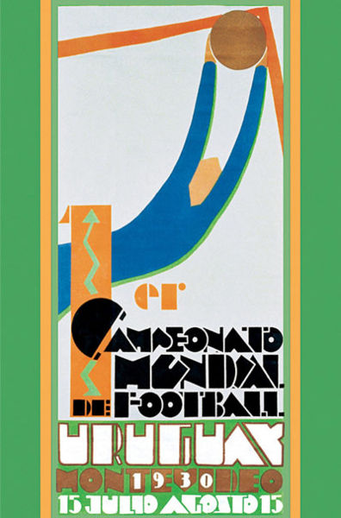
Football World Cup in 1930
The World Cup in 1930 was the first official World Cup to open a new page in football history. It was held in Uruguay from 13 to 30 July. FIFA chose Uruguay as the first host at a meeting in Barcelona because Uruguay celebrated the centenary of independence in Uruguay in 1930.Thirteen teams competed at the first World Championship, four of them from Europe, and nine from South and North America.
Thirteen teams were divided into four groups. The first group is Argentina, Cile, France, Mexico: Argentina goes to semifinals. The other group is Brazil, Yugoslavia i Bolivia: Yugoslavia goes to semifinals. In the third group are Uruguay, Peru and Romania: Uruguay goes to semifinals. In the fourth group are US, Belgium and Paraguay: US goes to semifinals.
In the semifinals were played by Argentina and US, and Yugoslavia with Uruguay. Argentina beat the US 6:1, and Uruguay defeated Yugoslavia 6:1.
In the final played Uruguay and Argentina Uruguay defeated Argentina 4:2.
The first title of Yugoslavia was the championship in 1924 when Yugoslavija defeated Hajduk 2:1

Slide 15
Summer Olympics in the 1960s Rome
During the Olympic Games, from August 26 to September 10, a football tournament was held in seven Italian cities. Sixteen teams participated in the tournament, which were divided into four groups in four teams in the first qualifying phase.
Grupa1: Bulgarian, UAR, Yugoslavia, Turkish:Yugoslavia goes further into the semifinals
Grupa2: Brazil, Italy, R China, UK: Italy goes further into semifinals
Grupa3: Argentina, Denmark, Poland, Tunisia: Denmark goes further into semifinals
Grupa4: India, Hungary, Peru, France: Hungary goes further into semifinals
Hungary and Italy played match for the third place where Italy lost of Hungary 2:1.
In the final match of Yugoslavia and Denmark, Yugoslavia became the Olympic champion with a victory of 3:1.

Slide 16
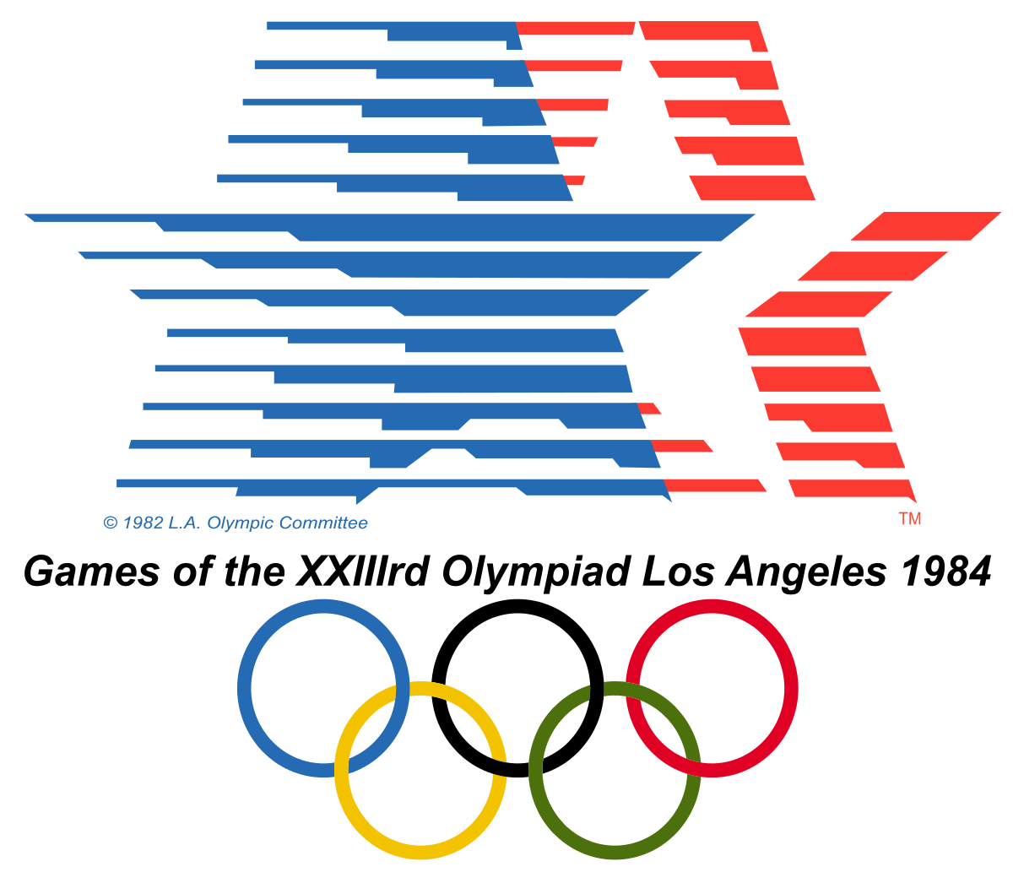
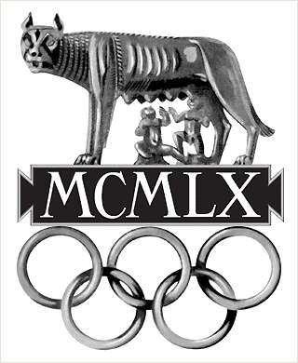
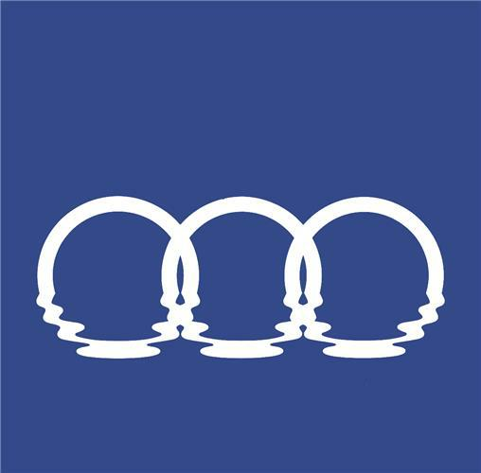
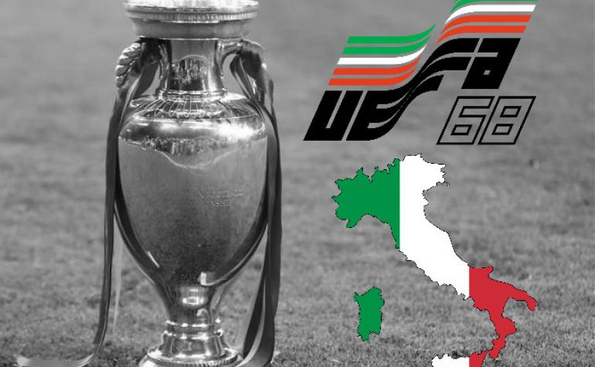
Medals of Yugoslavia
Olimpijske igre:1960. gold-Rim, 1948. silver-London, 1984. bronze-Los Angeles,...
European championship: 1960. silver-France, 1968. silver-Italy
Mediterranean Games: 1971. gold-Izmir, 1979. gold-Split

