Slide 1
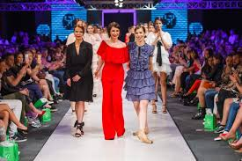
Fashion and style

Slide 2
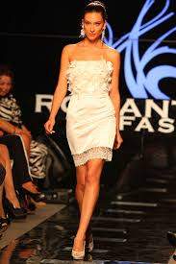
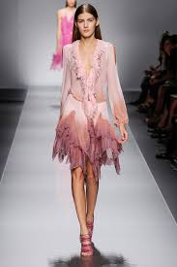
In a sense,word of mouth is a way of dressing people. Fashion consists of styles and each style is specific in its own way.

Slide 3
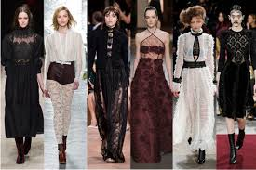
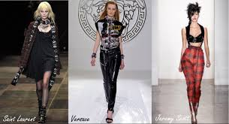
Styles and fashion details,as well fashion designs and designs are fashioned by fashion stylist.
They create creations that later present themselves in fashion shows.

Slide 4
Thierry Mugler
Thierry Mugler is a French fashion and fragrance designer.
Ever since he was a young boy, he was interested in drawing and specifically designing dresses.
He moved to Paris at 24 and began designing clothes for a Parisian boutique.
He worked as a freelance designer.
He opened his 1st boutique in 1979 and during the 80's and 90's he became a world renowned designer.

Slide 5
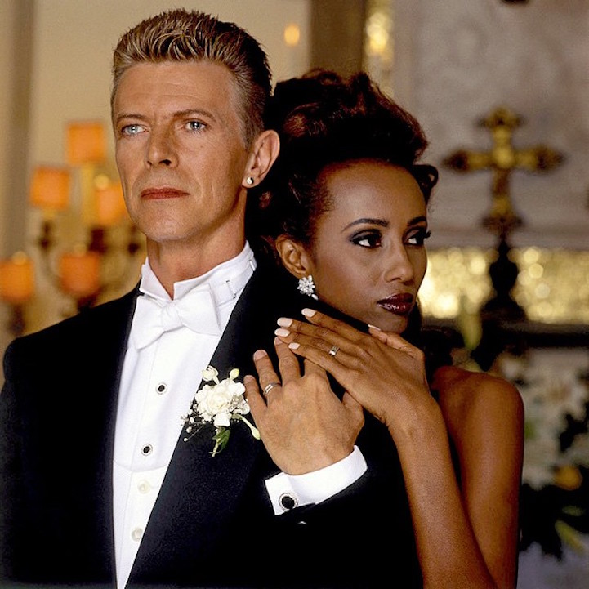
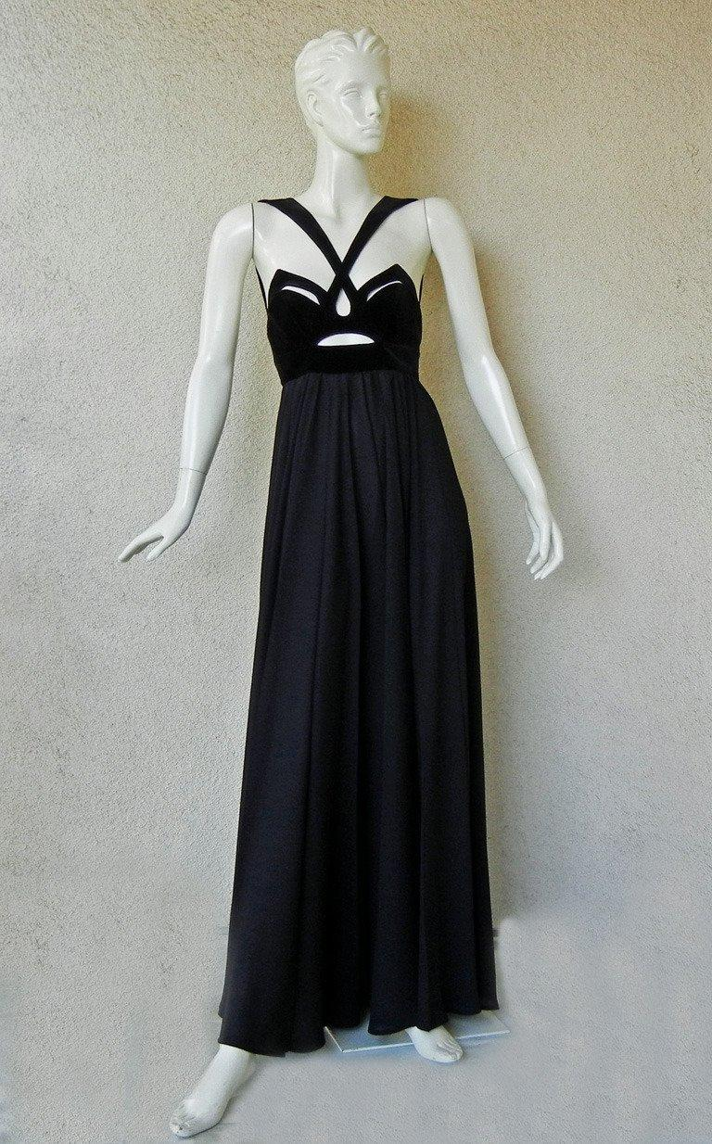
He designed for Demi Moore’s famous black dress in the film “Indecent proposal” and costumes for Beyoncé’s 2009 “I Am…” world tour.
He designers David Bowie’s famous suit for his wedding to Somali supermodel Iman.

Slide 6
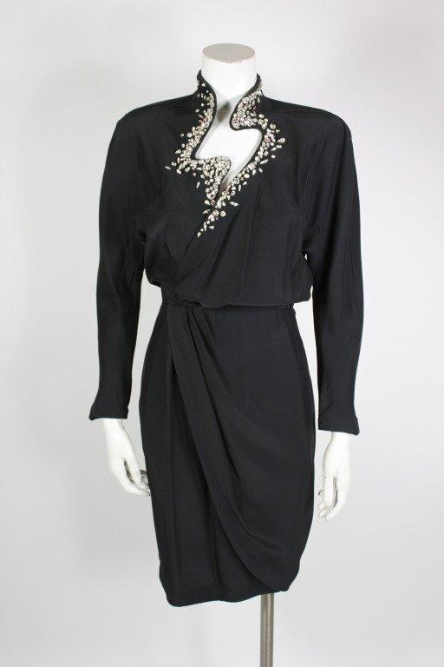
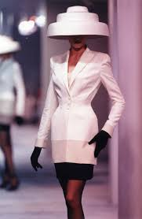

Slide 7
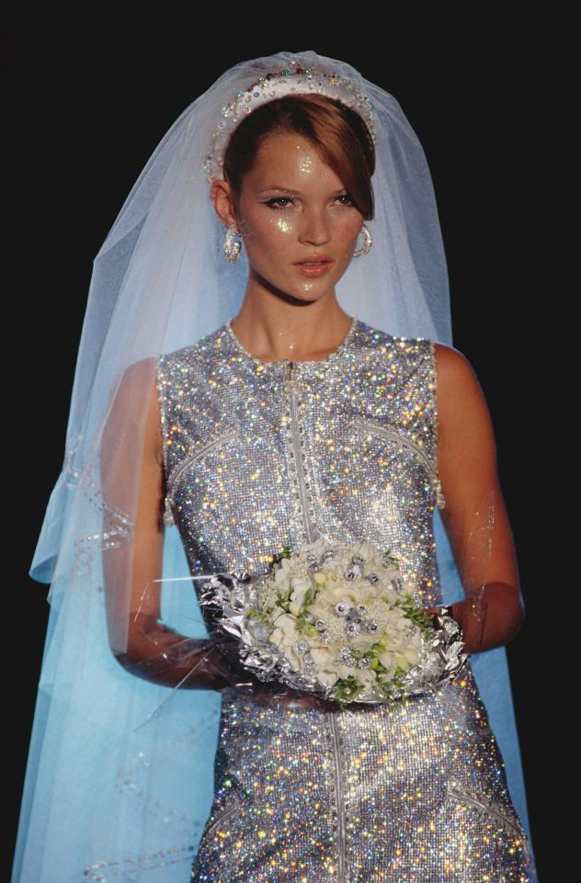
Gianni Versace
Gianni Versace was an Italian fashion designer who founded the luxury fashion company - Versace, alongside his sister Donatella.
They were independent designers who had control over everything in the label - designing, retailing, etc.
In 1993, Donatella Versace created her own diffusion line - Versus. In 1997, after Gianni Versace was shot to death by Andrew Cunanan, Donatella became the creative head of the label.

Slide 8
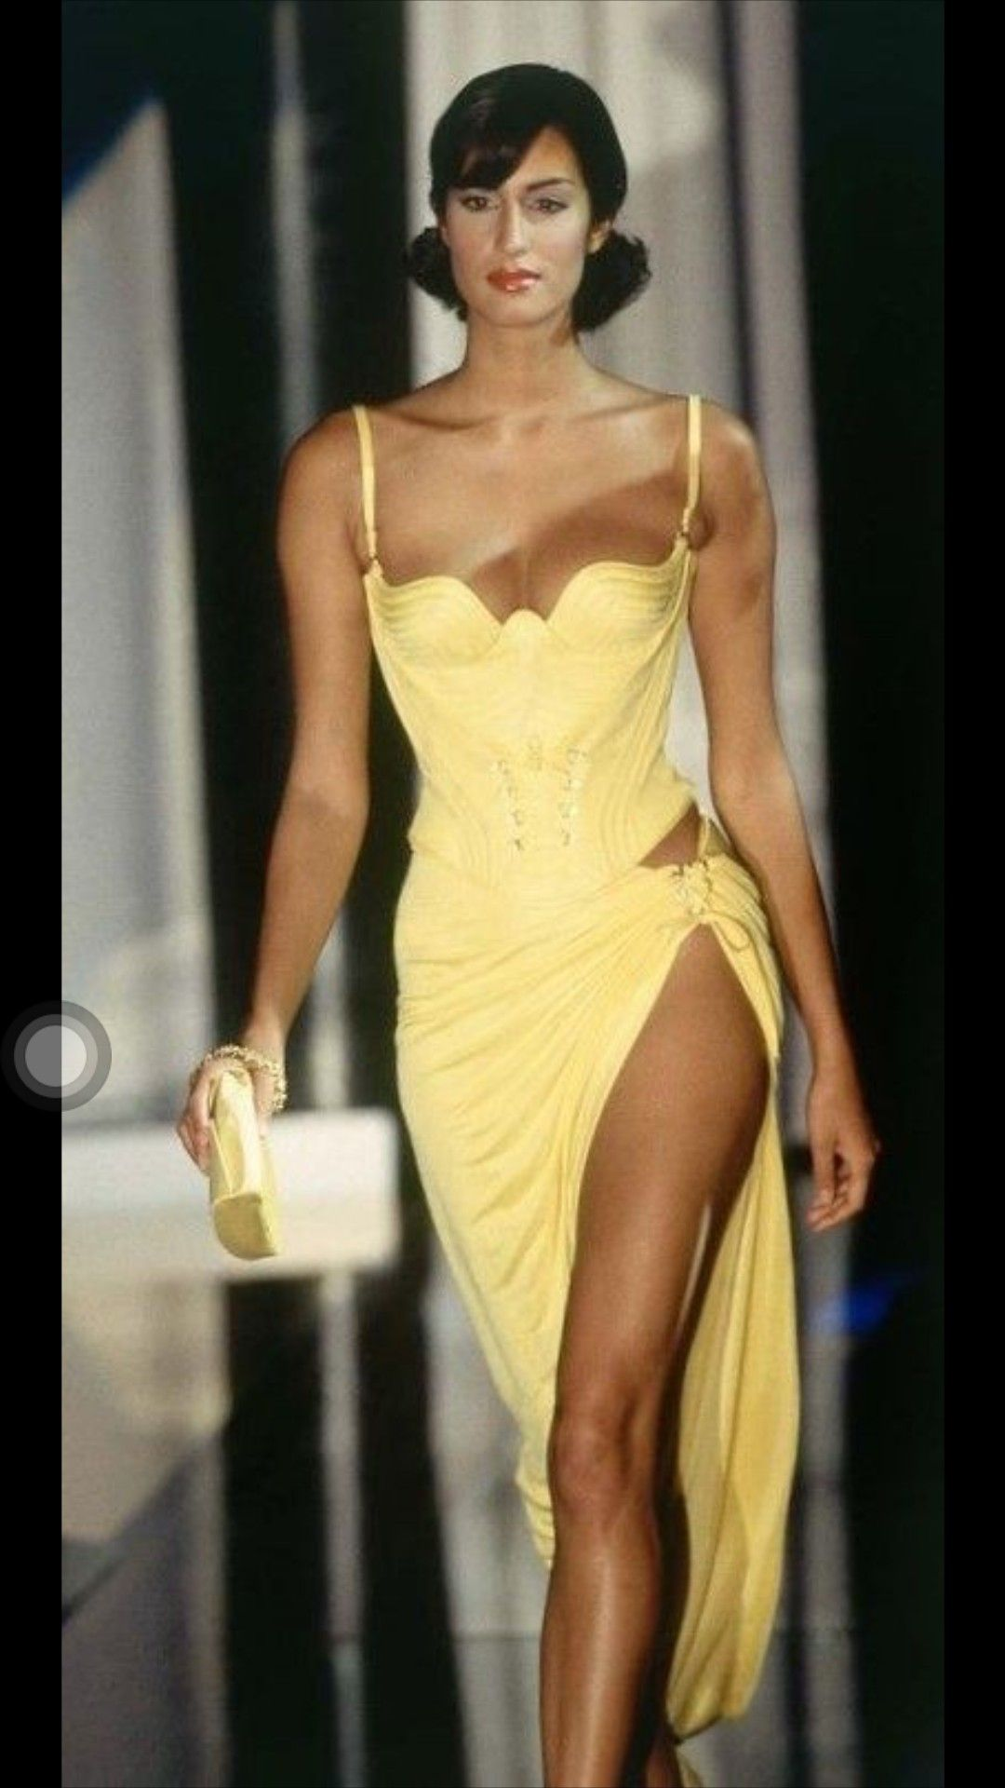
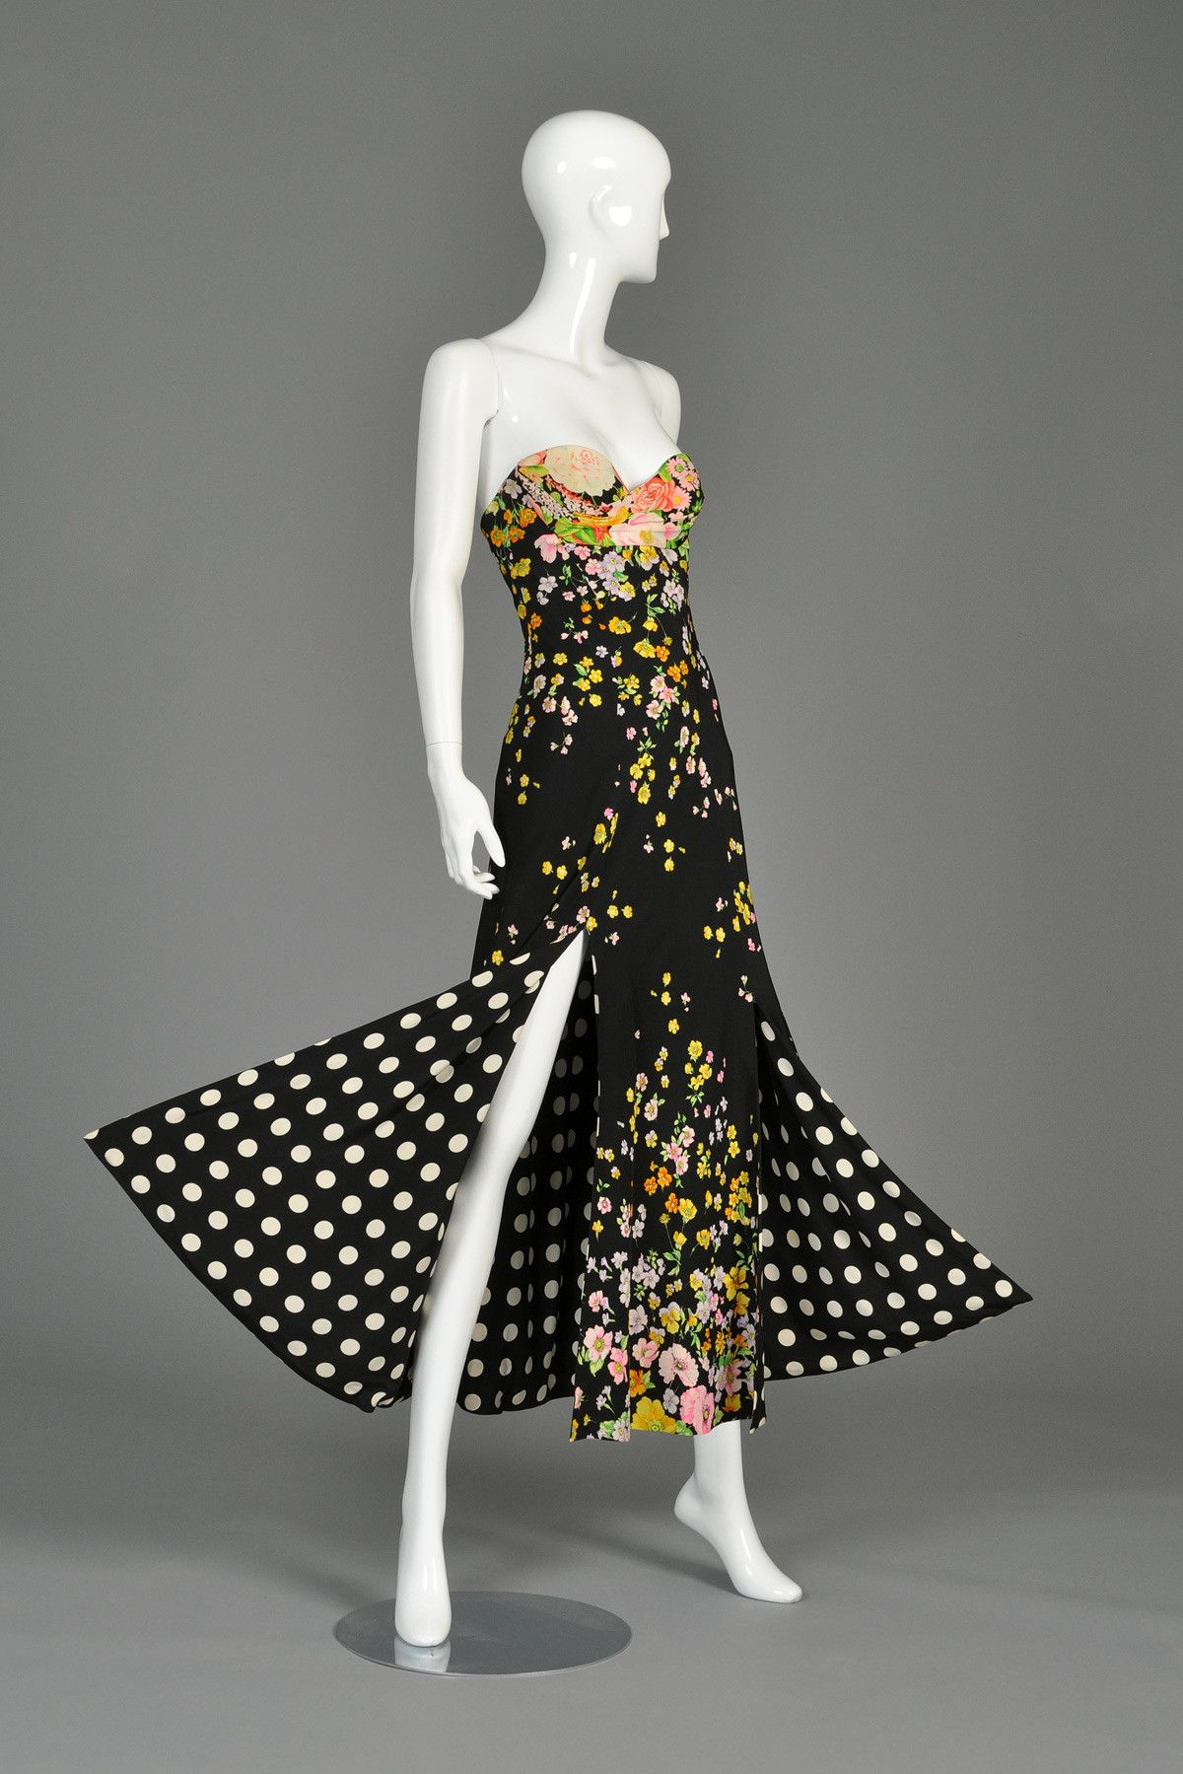
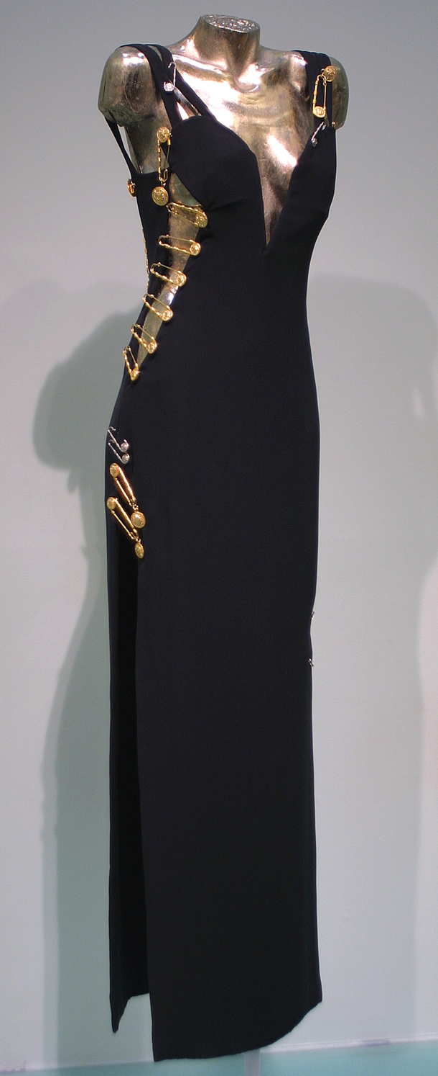

Slide 9
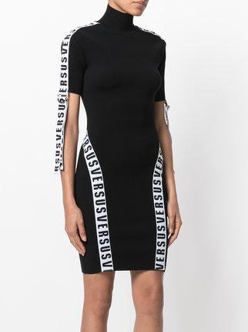

Slide 10
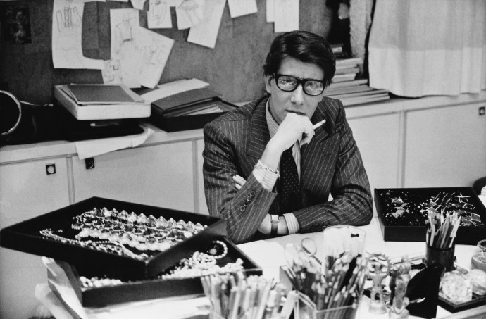
French fashion
Most often, first we think when we hear "France" is fashion.
France has always set new rules and standards when it comes to fashion. So it can be said that French designers have changed the fashion world.
1.Yves Saint Laurent - Yves Saint Laurent in the world known as the king of fashion. In the women's wardrobe he introduced some typical men's clothing items: blazer, smoking, safari jacket ..

Slide 11
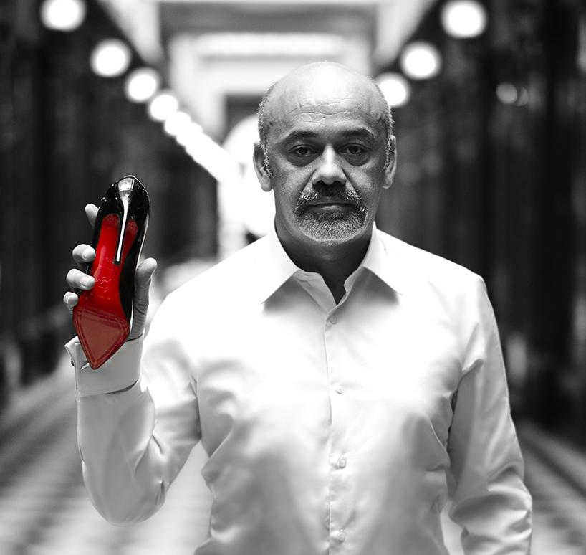
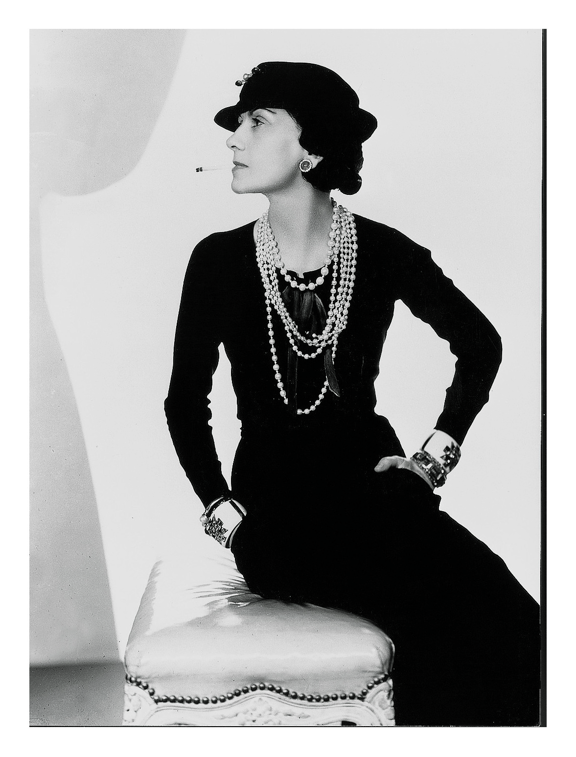
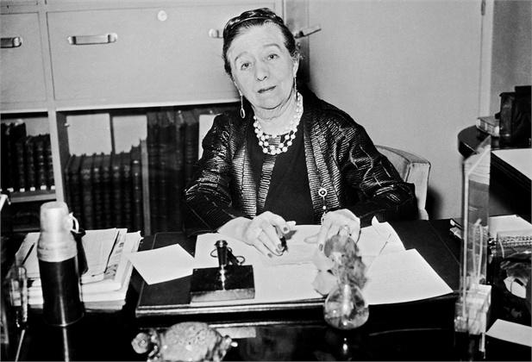
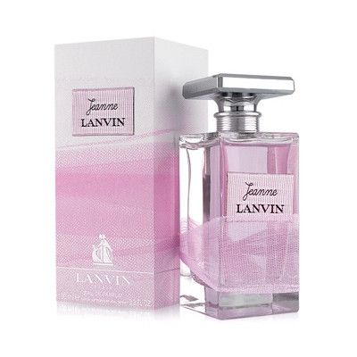
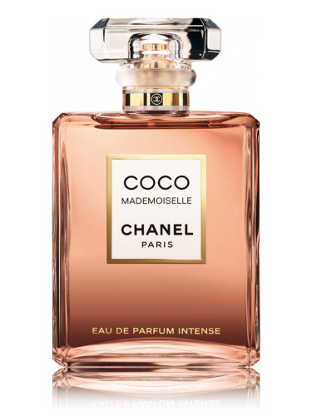
.
2.Coco Chanel She gave the world more comfortable cuts, shorter pants and trousers, and thus created a lady of the modern age.
3.Christian Louboutin Famous red soles are popular as well as a designer himself, and his style redefined fashion in the footwear industry. In addition to footwear, this designer creates bags. 4.Jeanne Lanvin She began her work by creating clothes for her daughter, who delighted the members of the elite, who asked her to do the same for them. However, her perfume industry made her an eternal symbol of fashion and elegance.

Slide 12
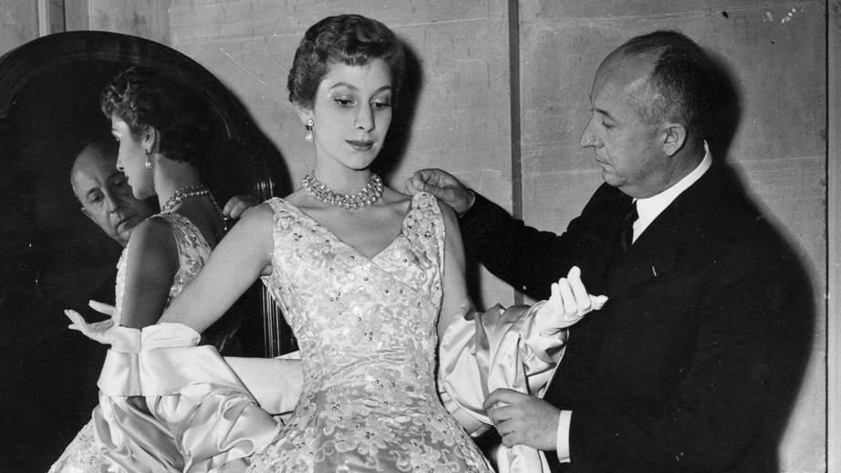
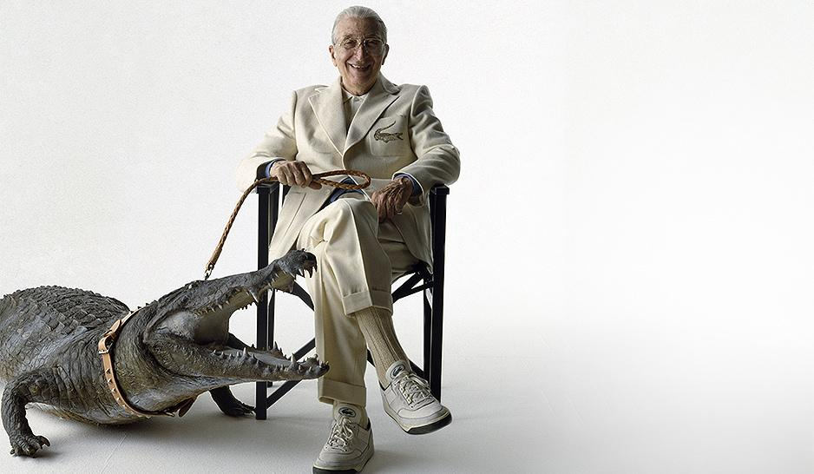
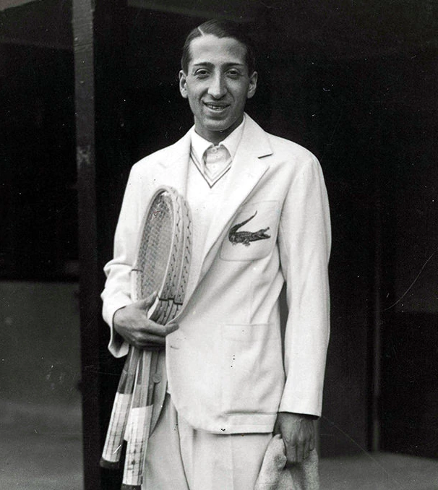
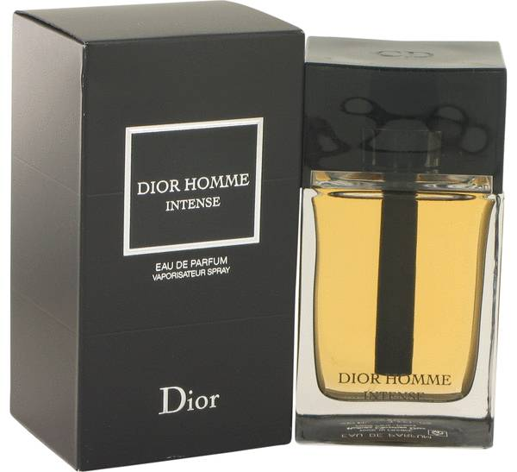
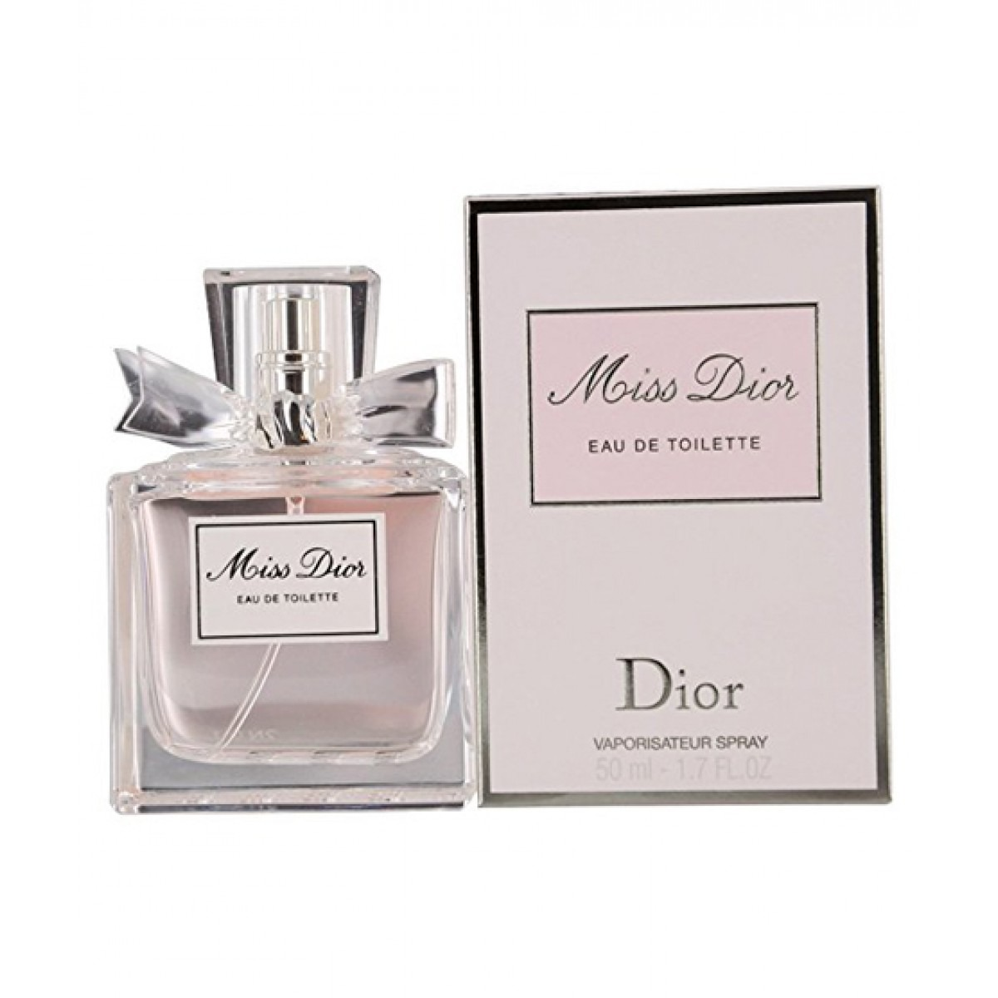
.
5. Christian Dior: Christian Dior can also be called the father of fashion. His fashion house is still in the spotlight and every year gives the world some novelty. 6. Rene Lacoste By 1950, Lacoste T-shirts, with the famous crocodile emblem on the left, conquered the United States and later the world.

