Slide 1
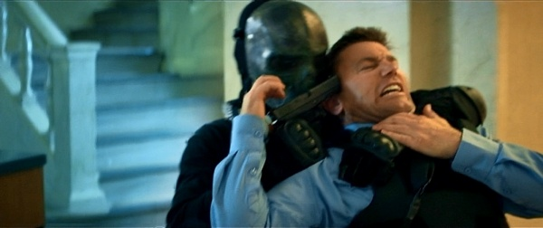
Crimes
Authors:
Lidija Vukićević
Sofija Shalabieh
Katarina Kojić
Tijana Vasović
Hristina Rakić
MURDER
•Murder is humans act that makes someone dead. It represents a consciously, deliberate and unlawful taking life of another person. Taking life of another person can be done at the several ways
Subject: English
Teacher: Milena Tasić

Slide 2
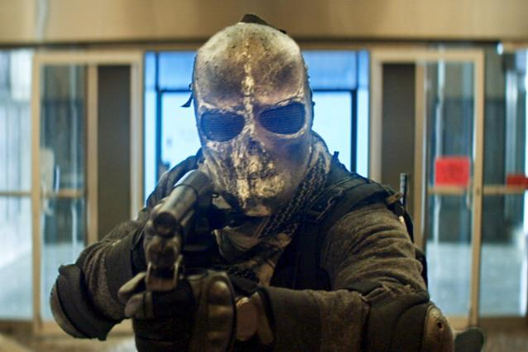
•Murder is one of the oldest human sins, known even from biblical myths. It represents the most harsh from the criminal act that human ever did through the whole human history. •Today, murder is being punished with the cruelest punishment. For example, if you kill your neighbor you will have to be in jail for at least 15 years. Of course, if they arrest you.

Slide 3
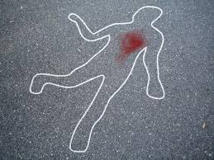
•These days, people are not killing each other like that. If someone wants to kill his target and does not want to be arrested, he or she will need some time to plan a good way to kill someone without being detected. •That is called a perfect crime. Until today, there weren’t any perfect crimes because soon or later, all the murderers were arrested. The greatest crime in human history took police and FBI 39 years to solve it, so far!

Slide 4
Theft
Theft is the taking of other things without the permission of the owner.
It belongs to criminal offenses.

Slide 5
Pink Panthers
Criminal band who steal jewelry. Their targets are located in several countries wich of them the robbery in Japan was the most successful. Some members are also called artists because of their extreme speed and abilities.

Slide 6
Prevent theft
Today thefts are prevented in various ways:
cameras that all recording in shops,school or oder buildings…
a special door that is recording if you unpaid goods
interior development of a good man with good education of the family, school and church.

Slide 10
RAPE
Rape is type of sexual assault usually involving sexual assault usually involving sexual intercourse carried out against a person without that person’s consent.
The act may be carried out by physical force ,coercion, abuse of authority or against a person who is incapable of giving valid consent ,such as one who is unconscious, incapacitated, has a intellectual disability or is below the legal age of consent.
The term rape is sometimes used interchangeably with the term sexual assault.

Slide 11
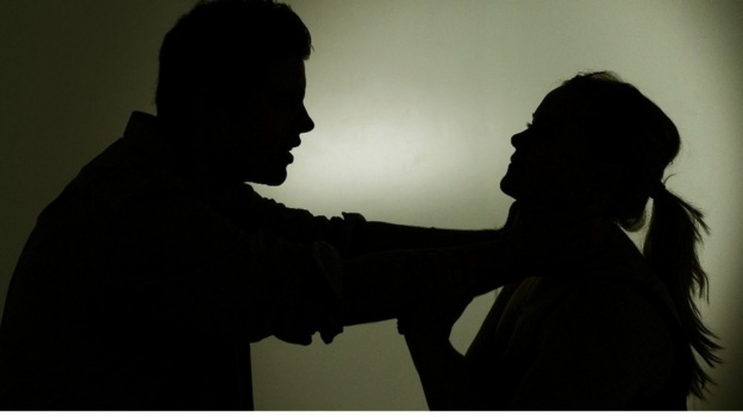
Internationally, the incidence of rapes recorder by the police during 2008. ranged, per 100 000 people.
Worldwide ,rape is primarily committed by males.
Rape by strangers is usually less common than rape by persons the victim knows.

Slide 12
Widespread and systematic rape and sexual slavery can occur during international conflict.
Rape is also recognized as an element of the crime of genocide when committed with the intent to destroy, in whole or in part, a targeted ethnic group.
People who have been raped can be traumatized and develop posttraumatic stress disordered.
Serious injuries can result along with the risk of pregnancy and sexually transmitted infections.
A person may face violence or the rapist, and, in some cultures, from the victim’s family and relatives.

