Slide 3
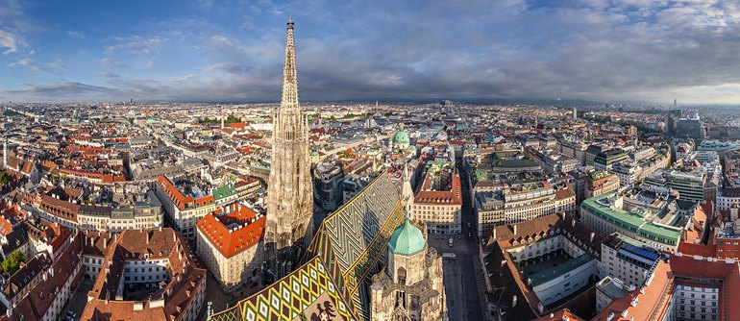
Austria Vienna
Vienna is an Austrian state. It is the capital of the Republic of Austria and by far the largest city in Austria with its population of more than 1.7 million. As you'd expect it's Austria's cultural, economic, and political centre.
The city lies on the Danube in the eastern part of Austria not far from the border with Slovakia, Hungary and the Czech Republic

Slide 4
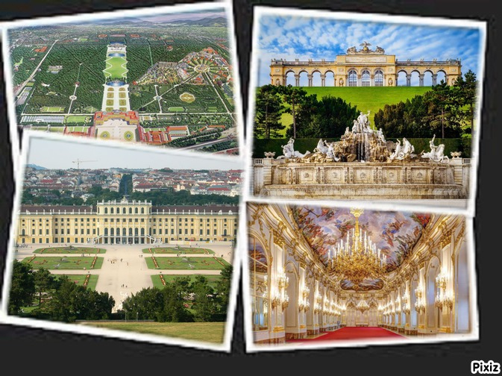
Schonbrunn Palace
The 1,441 room Schönbrunn Palace, comparable in grandeur to Versailles, is one of the major tourist attractions in Vienna. The palace was built between 1696 and 1712 at the request of Emperor Leopold I and turned into the imperial summer palace by Maria Theresa. The Palace Park offers a lot of attractions, such as the Privy Garden, the oldest zoo in the world, a maze and labyrinth, and the Gloriette, a marble summerhouse, situated on top of a 60 meter (200 feet) high hill.

Slide 5
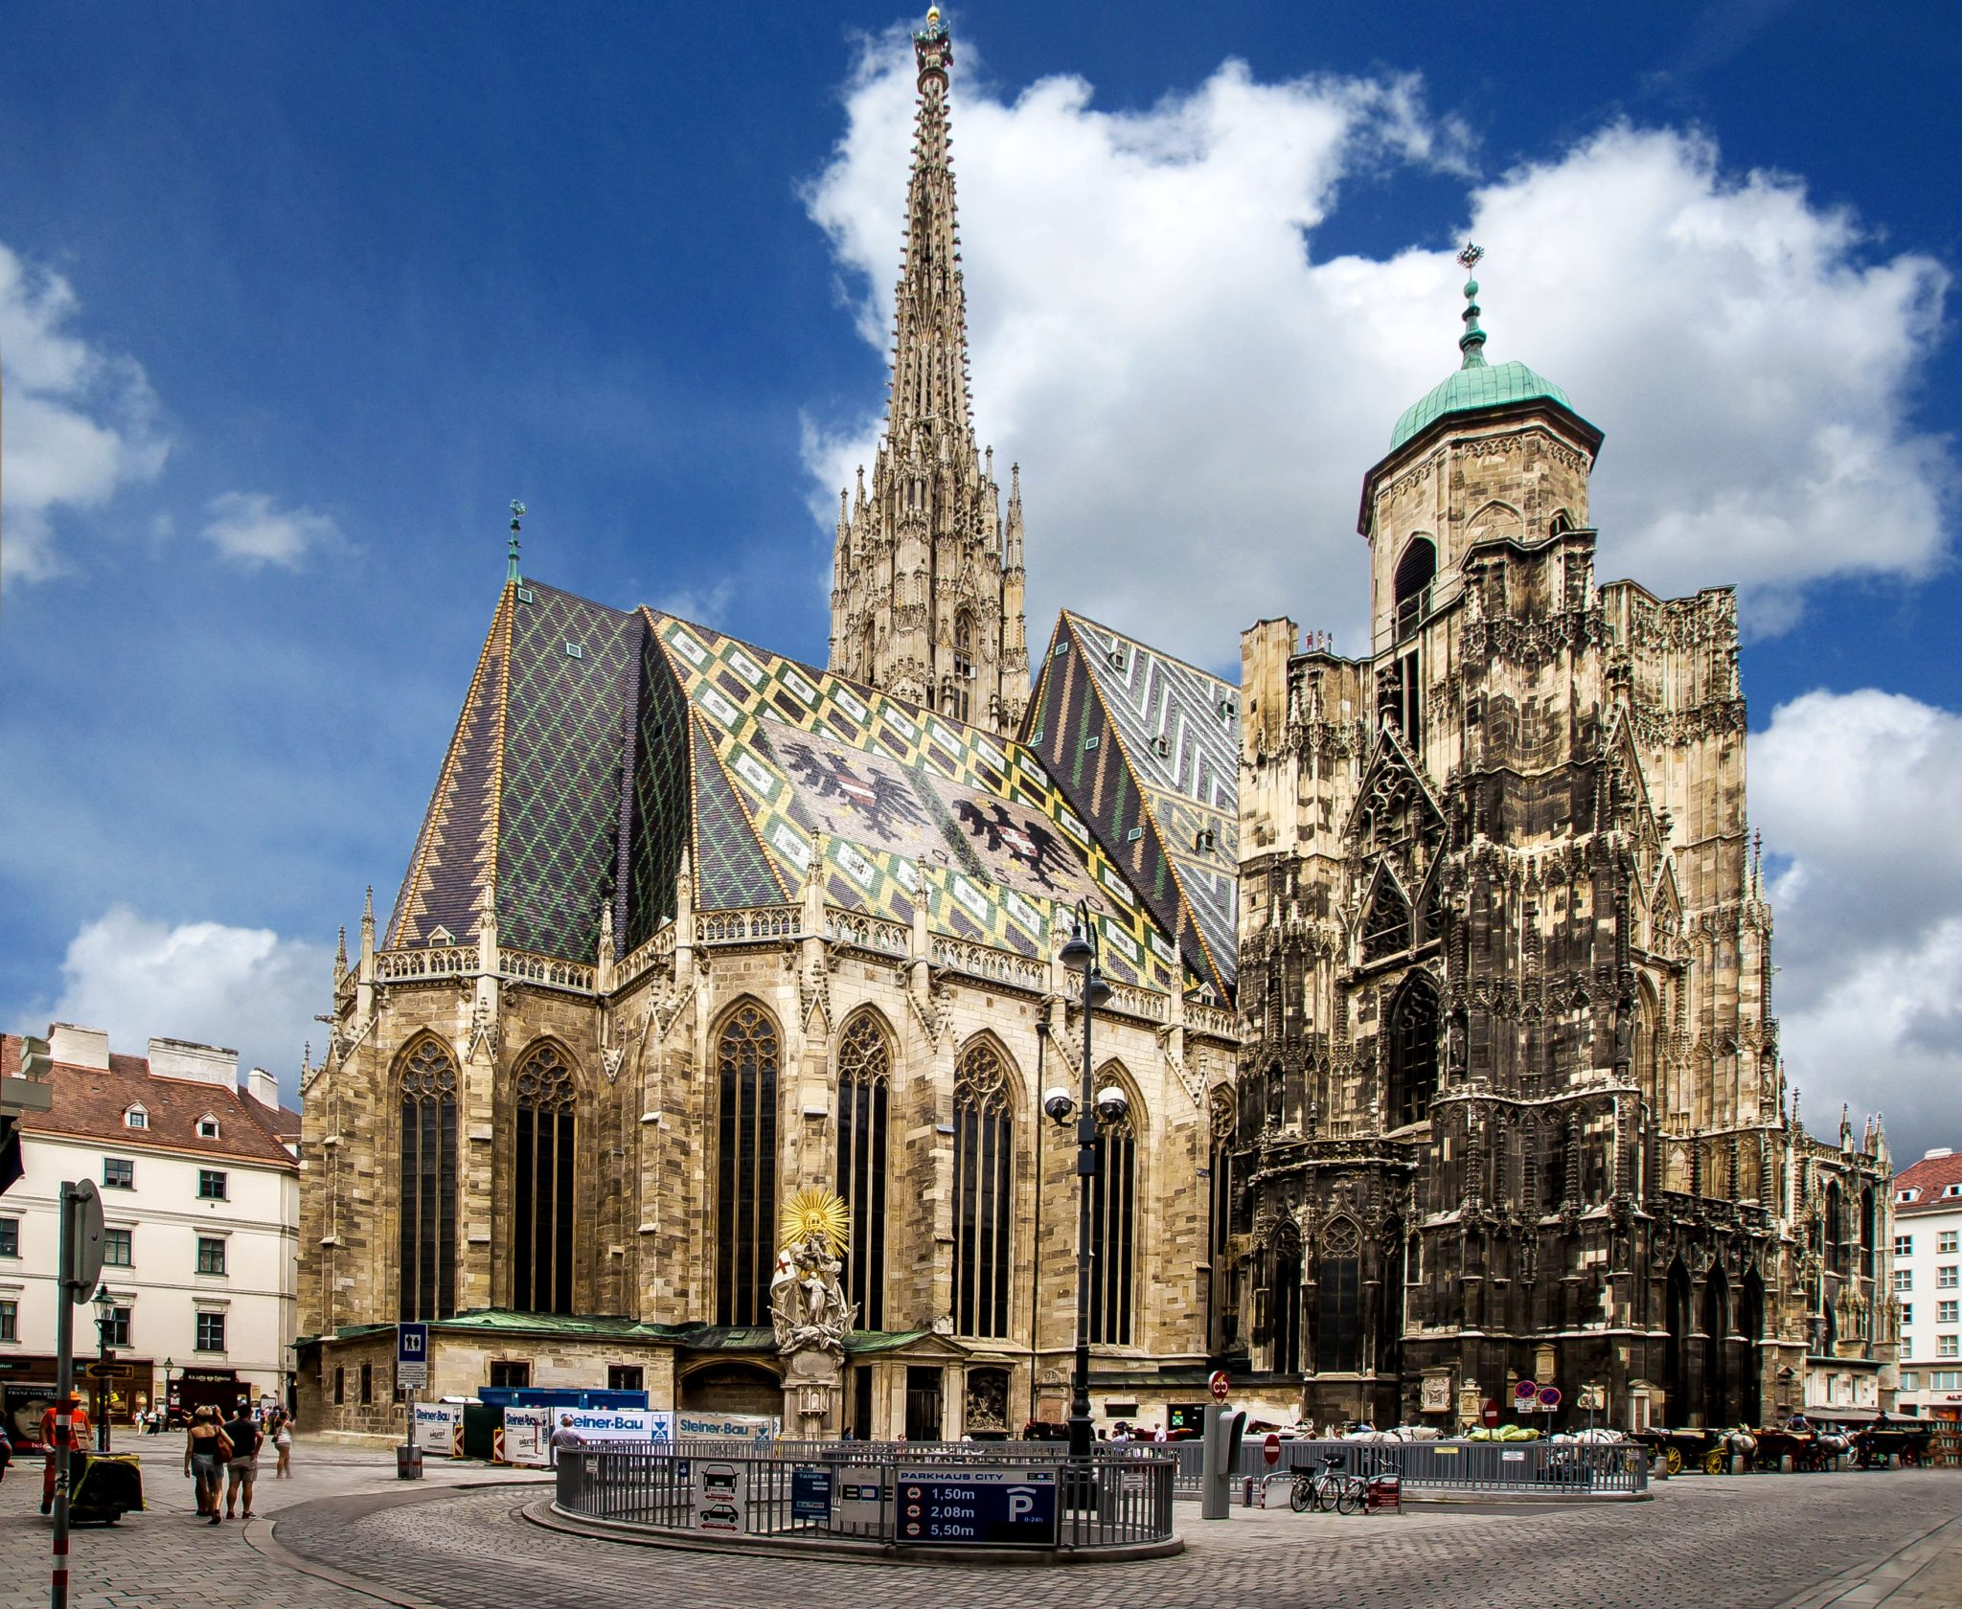
St Stephen’s Cathedral
St. Stephen’s Cathedral, also known as Stephansdom, had humble beginnings as a parish church in the 12th century. Today, it is the home church for the Catholic archbishop in Vienna. The church was destroyed in World War II but was rebuilt in seven years, with worship services still held daily. The cathedral, one of the city’s most important landmarks, reaches high into the Viennese skyline. Its impressive roof is covered by 230,000 glazed tiles. The cathedral has more than 18 altars, all built at different times, and contains precious works of art as well.

Slide 9
ITALY / VENICE
Venice is a city, a dock and a famous tourist destination in northeastern Italy, on the Adriatic Sea.

Slide 10
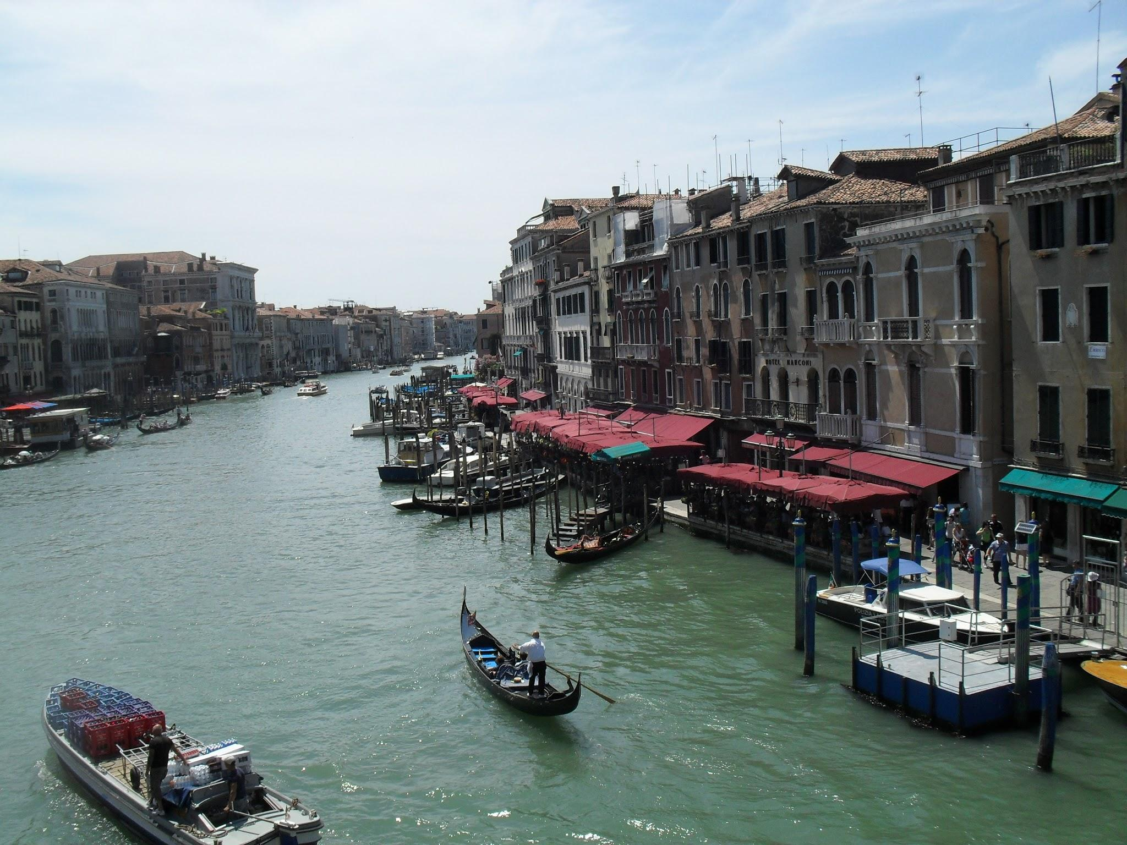
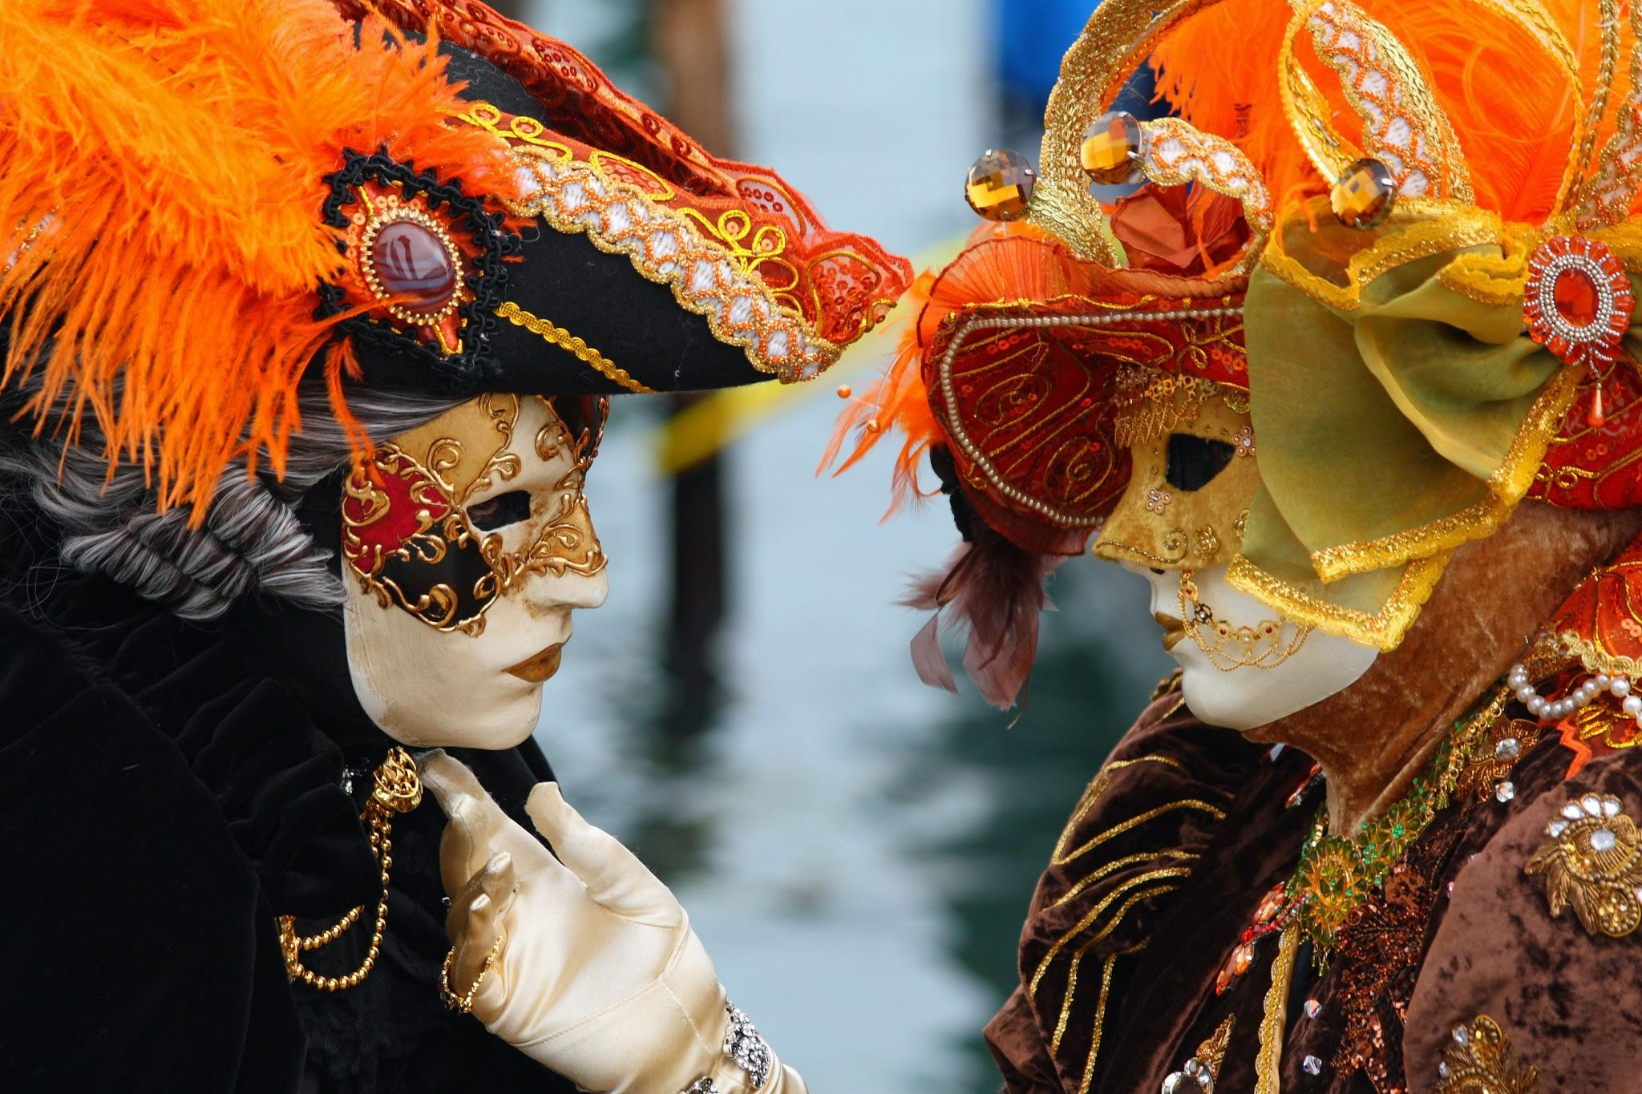
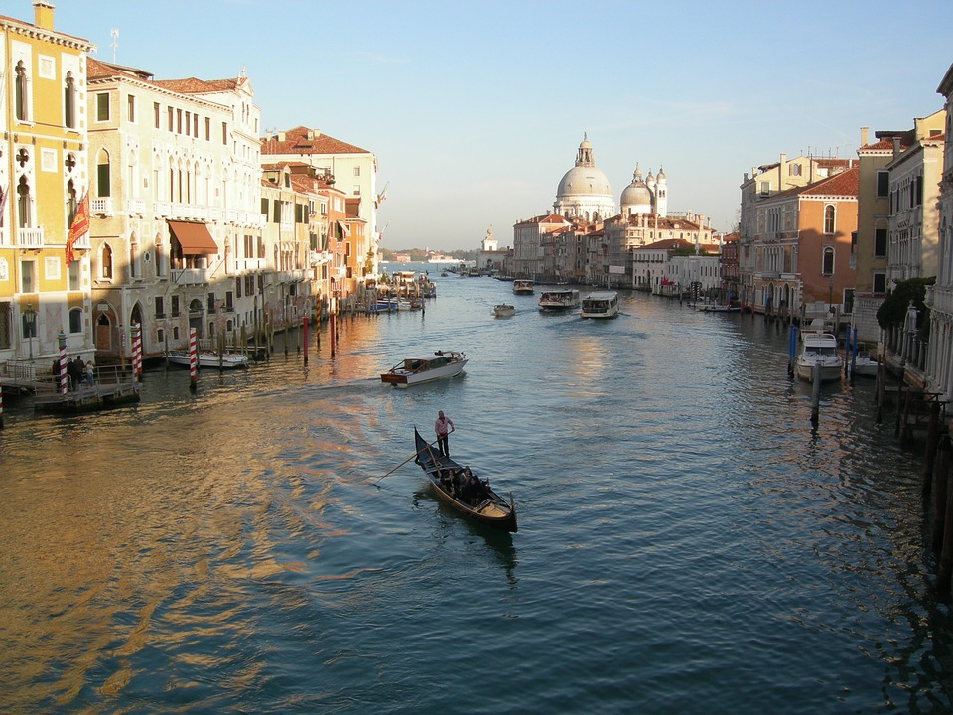
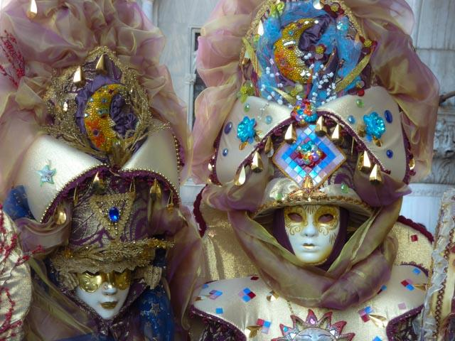
INTERESTING FACTS
Floating city-how the Venetians came into being
Carnival in Venice-masks
Gondola

Slide 11
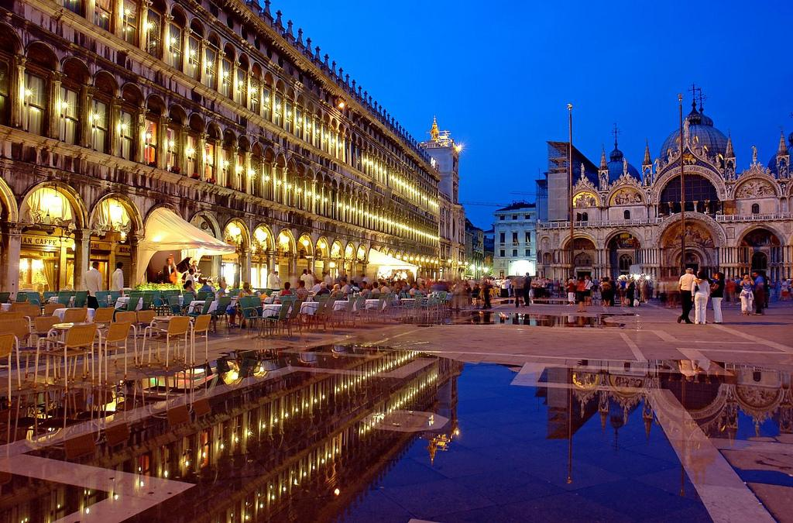
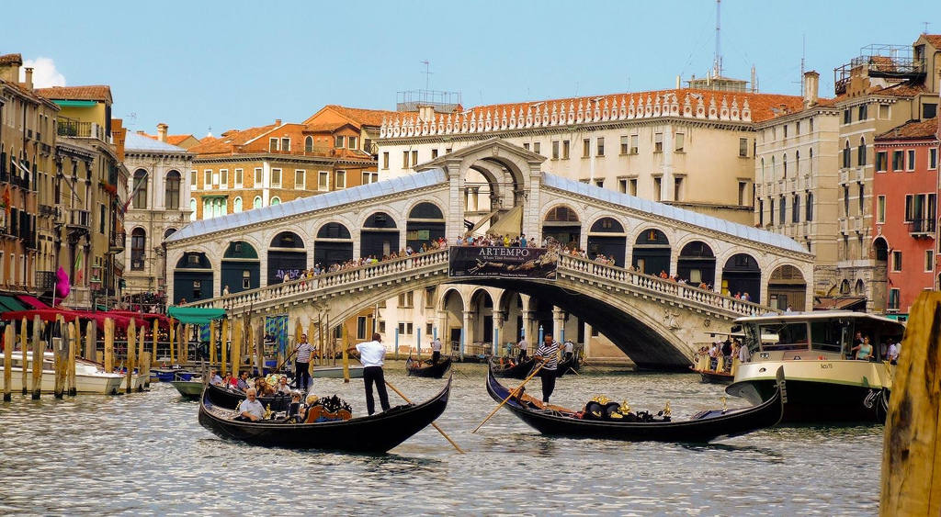
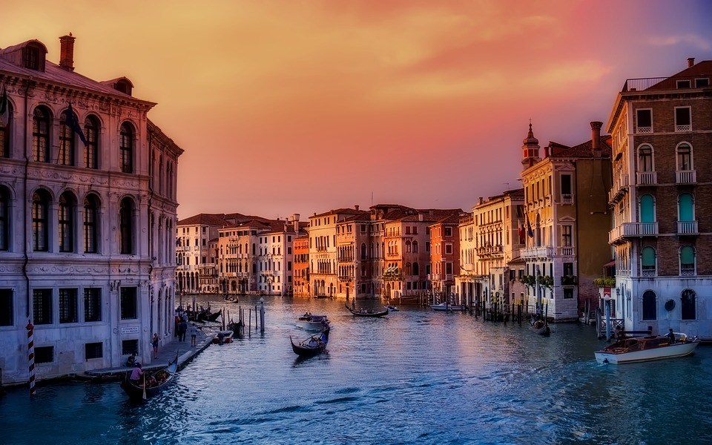
Places to visit
Bridge RIALTO
A clock TORRE DELL’ OROLOGIO
Duyd’s palace and basilica-Hall 4 trial and torture,Bridge of sighs,Golden staircase,High council hall ,The walls of the Venetian Biennale

Slide 12
FRENCH LION
Lyon is the capitol of the Rhone-Alpes region and the Rhone departmant in eastern France.
The city is located at the mouth of the Saone River in the Rhone River.
Lyon is the third largest city in France after Paris and Marseilles.
With about 1,3 million inhabitants in the wider urban area the Lion’s region is the second largest in the country after Paris.
The city is also known as the center of French gastronamy.

Slide 13
INTERESTING FACTS
LA PLACE BELLECOUR-The biggest square in the city, the fourth largest in France and the largest pedestrian square in Europe.
The centar park dominated by a monument devoted to Louis XIV.
This Franch king is part rayed on a horse and the monument is often a place of meeting of the inhabitants and visitors to the city.
On the square are also expire and a Little prince.

Slide 14
