Slide 7
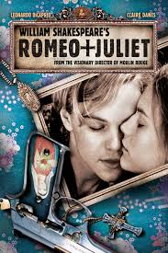
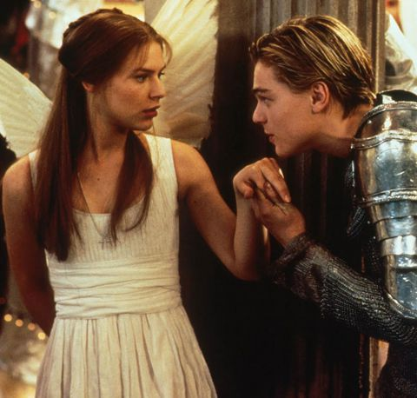
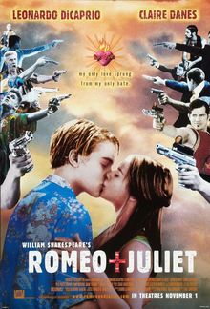
Romeo + Juliet
While it retains the original Shakespearean dialogue, the film represents the Montagues and the Capulets as warring mafia empires (with legitimate business fronts), and swords are replaced with guns (with brand names such as "Dagger" and "Sword"). Some characters' names are also changed.

Slide 8
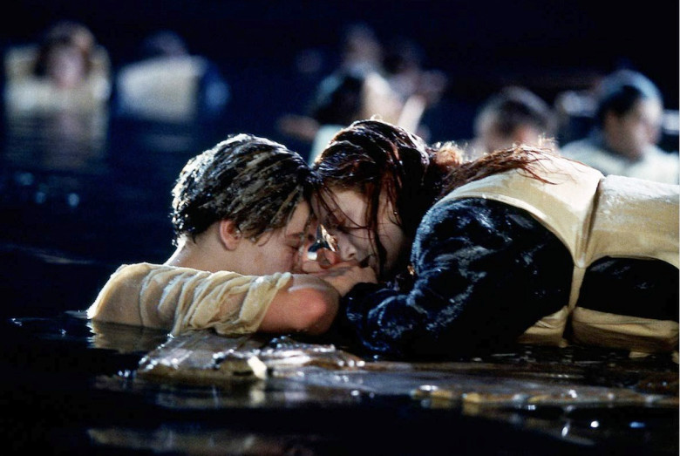
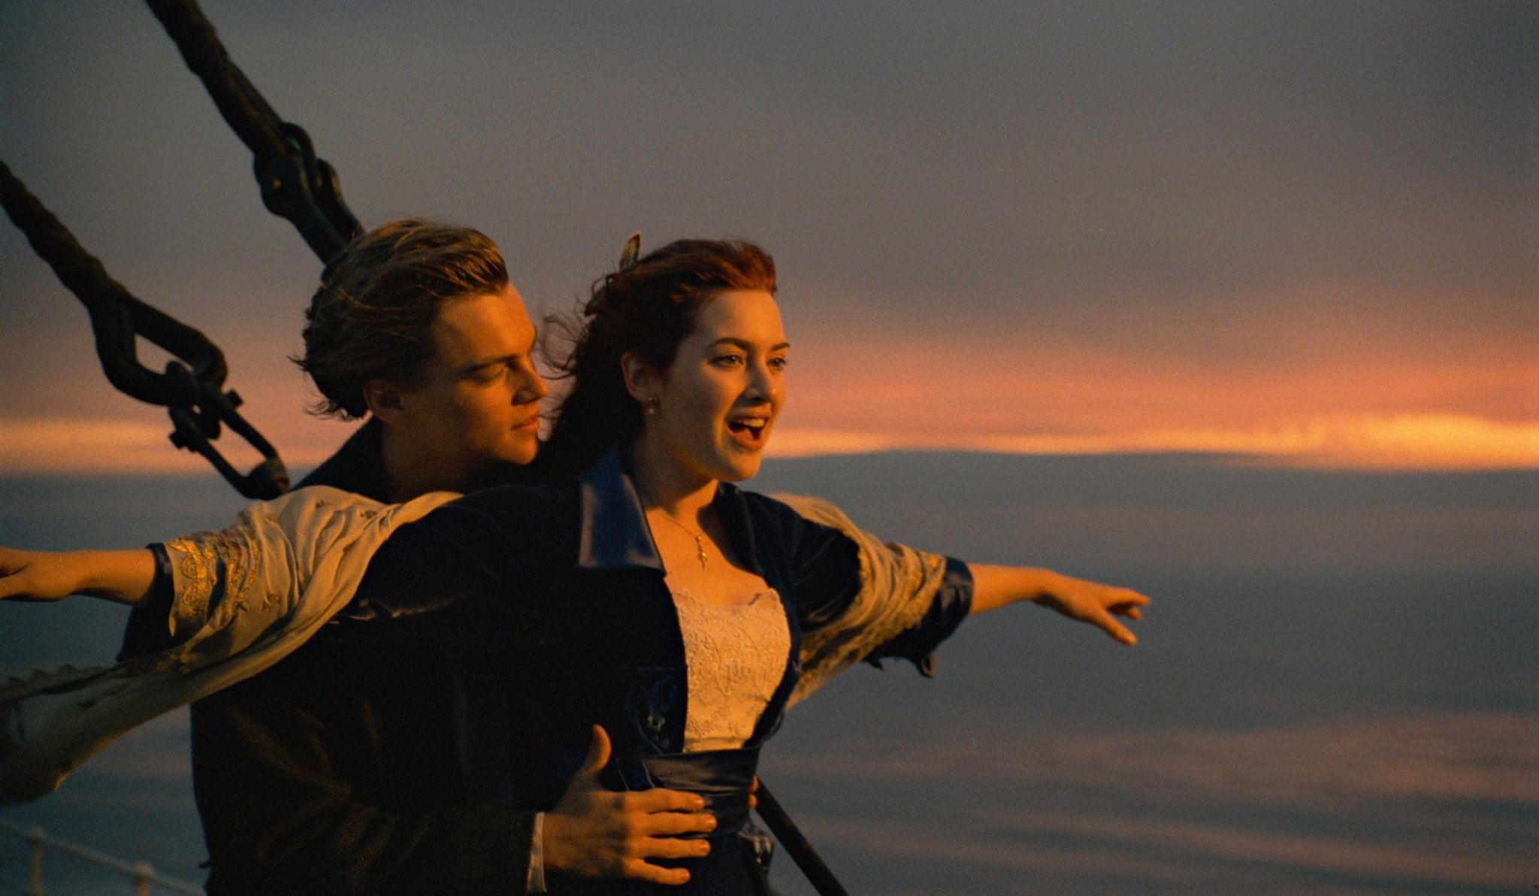
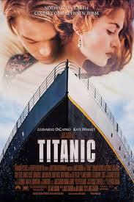
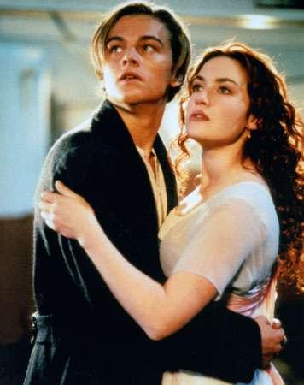
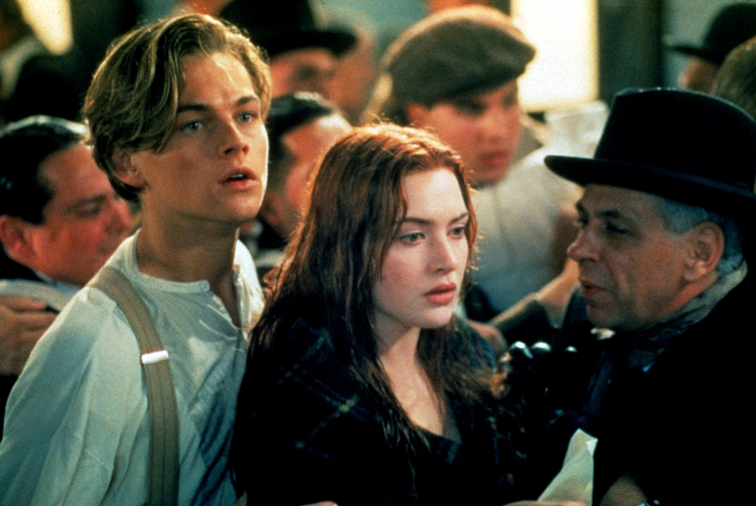
Titanic
Titanic is a 1997 American epic romance-disaster movie.

Slide 9
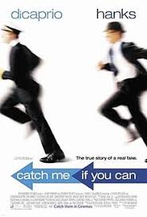
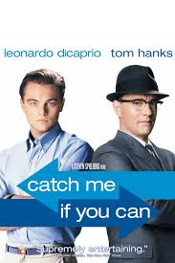
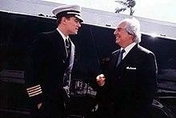
Catch me if you can
Catch Me If You Can is a 2002 American biographical crime film directed and co-produced by Steven Spielberg. The film is based on the life of Frank Abagnale, who, before his 19th birthday, successfully performed cons worth millions of dollars by posing as a Pan American World Airways pilot, a Georgia doctor and a Louisiana parish prosecutor.

