Slide 1
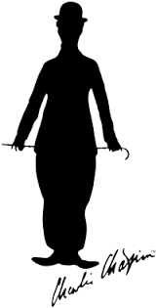
Charlie Chaplin
(born 16|4|1889-died 25|12|1977)
Marina Filkovic,Tijana Spasic,Biljana Golubovic,Ivana Visnjic i Milan Rosic.
Teacher:Milena Tasic
English

Slide 2
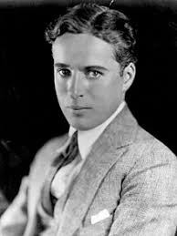
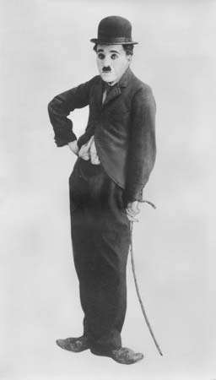
The beginning of his career
-Charles Spencer Chaplin, known as Charlie Chaplin, was an English film director, actor, screenwriter and producer of British origin, one of the greatest comedians of all time.
-His start was very cruel.After the tragedy that happened to him when he was five years old (his mother was nervous and his father died), he and his half-brother Sydney Chaplin became homeless.After a short time spent in the home of uninhabited children, Charlie became a member of poor children and theater troupes in which he played several minor roles. At the age of eight he began to perform himself.

Slide 3
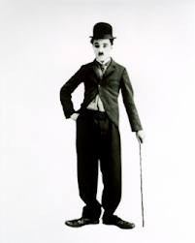
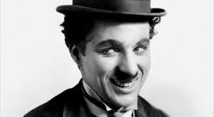
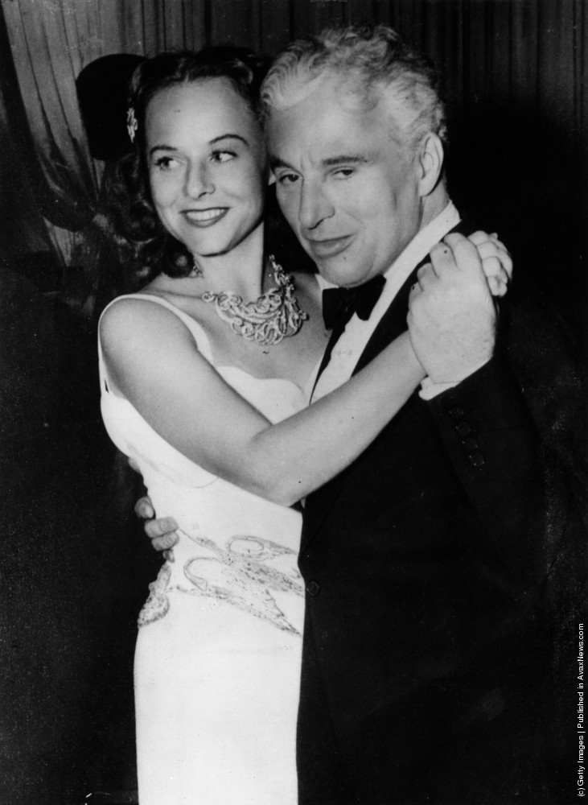
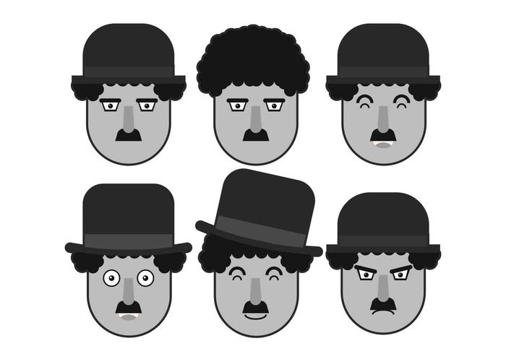
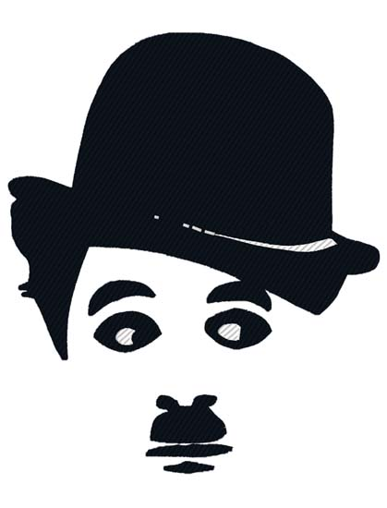
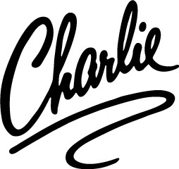
Films and women
-Chaplin's comedy, rooted in his poor detention in London, was a greater personal, blend of sense of nostalgia and horror over social untruth. His humor was based on characterization and places of events, and in films he collaborated with Charlie as a policeman (Easy Street, 1917) and Charlo Immigrant (1917) deals with controversial topics such as drug abuse, street crime and prostitution.
-Charlie Chaplin’s first wife was Mildred Harris (1918-1920).His second wife was Lita Grey (1924-1927). Charlie Chaplin’s third marriage was to Paulette Goddard (1936-1942).Charlie Chaplin married Oona O’Neill in June 1943.Charlie Chaplin had a lot of love affairs and affair, four marriages and ten children. His wives were more than 30 years younger than him, which was why he was criticized by the public.
-He appeared in the film in 1914 and recorded his first silent film - "Keystone Was Making a Living" and another Children's Auto Race in Venice ("Kid Auto Races at Venice", 1914).
-While working on his second film in 1914, Chaplin devised a figure of trampolines and costumes - sweatshirts, polucilinders, oversized shoes and rods - which became a trademark of his famous film character of a small trampoline developed by his entire career and who marked early history film industry.

Slide 4
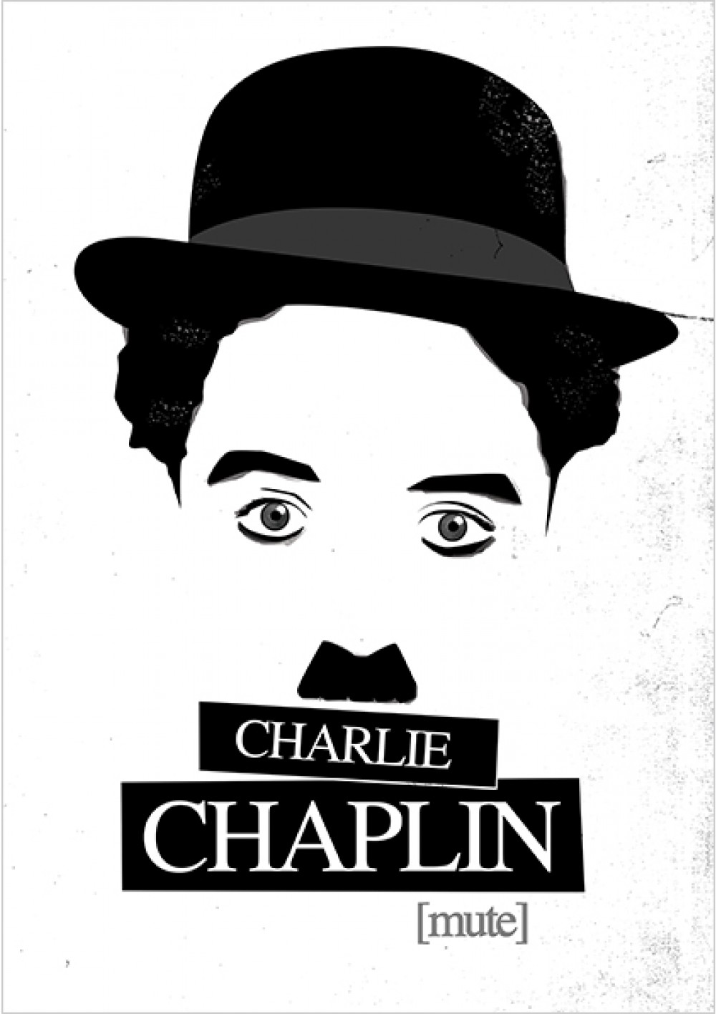
Charlie Chaplin is regarded as the greatest comedian of all time. During the time of dark, black and white films, when there was no chance for a joke to sound a joke on the screen, and thus embarrassing the audience, Caplin managed to bring people at noon with their gags and actions. He is one of the figures that marked the twentieth century, although black and white films have long been behind us.

Slide 5
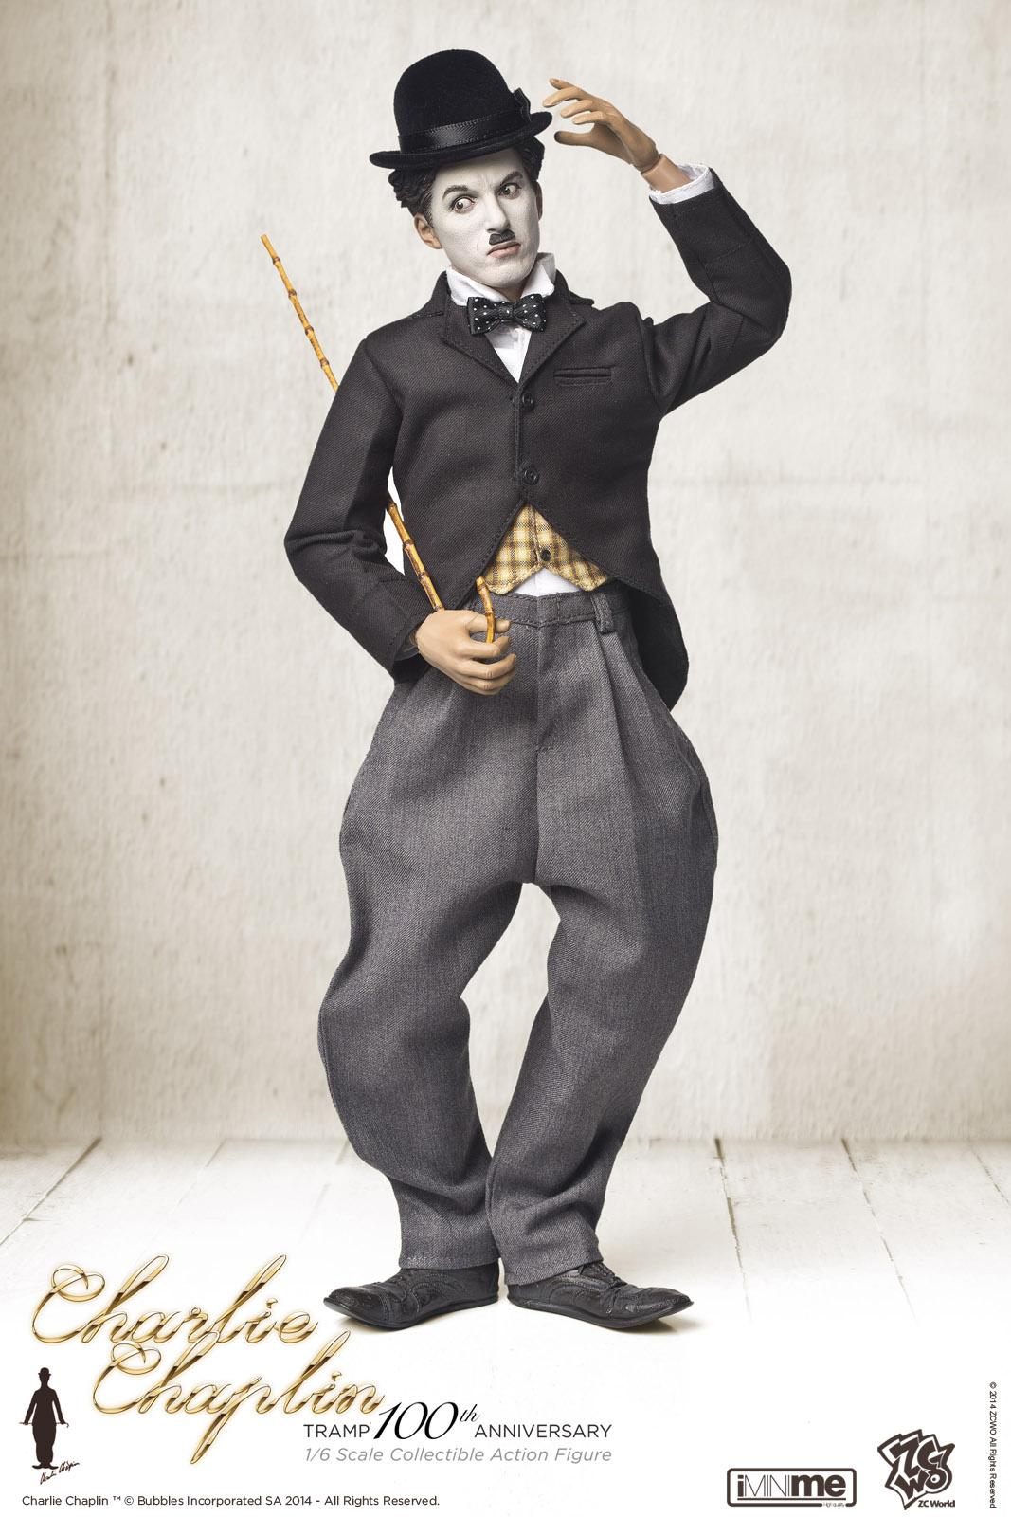
First film without sound
After a short time spent in a home for uninhabited children, Charlie became a member of a children's musical and theater troupe, in which he had several supporting roles. Soon he became an actor of the Keystone Company, who organized theater performances. As one of the best actors of this company, he goes to America, where in 1914 he recorded his first two films - "Keystone Was Making a Living" and "Kid Auto Races at Venice".
In these films he showed the character that to this day has remained his trademark and thanks to which he became the first film star in the world. Baggy trousers, ridiculous cylinder and big shoes - marked the history of the film industry. In the coming years, he will record 20 films, and for the first time Edna Parvins will appear, which will be Chaplin's constant partner in films for the next eight years.

Slide 6
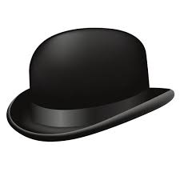
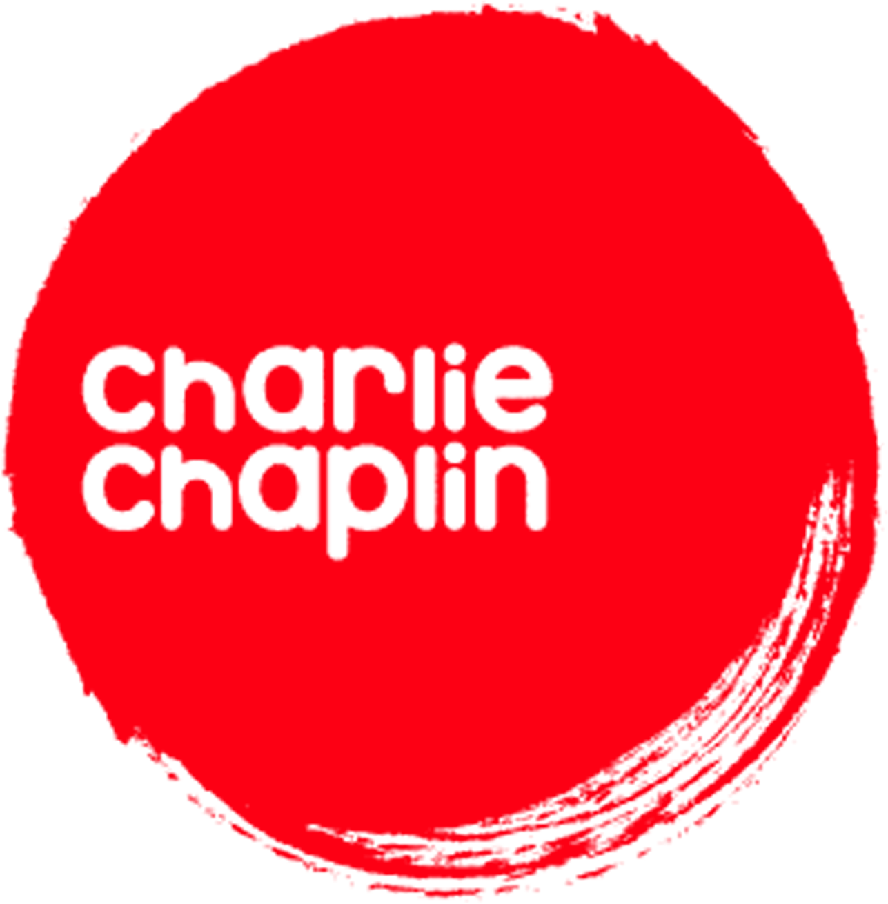
Becomes an independent film artist
Soon he becomes an independent film artist and starts filming independently. He worked as an actor, producer, screenwriter and director. His greatest successes until 1920 were the films "Dog Life" and "Deran".
He then set up his own film company, in
which, among other things, he filmed films with an already traditional character of the strayman. He achieved the greatest successes of the thirties with the films "Little Wanderer" and "Golden Fever". In 1928, for this second film, he received an Academy Award.
In 1931 he recorded his first film with music and sound effects. In the following years, he composed music for many old, silent films.

Slide 7
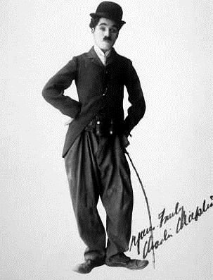
Sound movies
With the appearance of the soundtrack, many actors of silent films were left out of work, because they could not get into the sound well, that is, because everything was shot live, they sounded badly. However, Charlie Chaplin was not a mess. The first film with music and sound effects was recorded in 1931. In the following years he even composed music for many old, silent films.

Slide 8
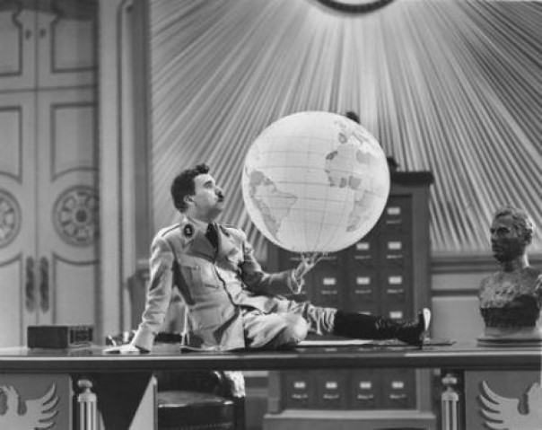
Charlie’s first sound movie and the role of Hitler
Chaplin often turned to hot political topics in his films, he reflected contemporary social events, which can best be seen in the famous film "Modern Times". When the appearance of Hitler and fascism in Europe was already seriously threatening the world in 1937, Chaplin also recorded his first-ever "Big Dictator" film, in which he acted Hitler, ridiculing him and Mussolini to the limit. They say that when Hitler saw this hilarious film, he promised to "hang the dwarf clown". In his later films, Caplin mocked many American politicians, and probably hides the reason why he fought in the 1950s secret services that tried to challenge Charlie Chaplin's biography in various ways and accuse him of sympathizing with communism. Because of his attitude that was openly expressed through films, Chaplin was prohibited in the 1950s to return to America from Europe. Faced with such a ban, Chaplin decides to live in Switzerland

Slide 9
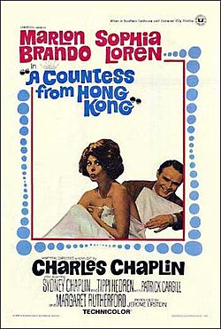
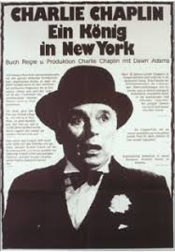
The last two films and the title of the king
His last two films, the King of New York from 1957 and the Countess of Hong Kong from 1963, Sofia Loren and Marlon Brando, filmed in Great Britain. "The King of New York" was banned in America until 1972 when he was invited to receive the Honorary Oscar. He spent the rest of his life as a composer and writer. British Queen Elizabeth II gave him the title of knight in 1975.

Slide 10
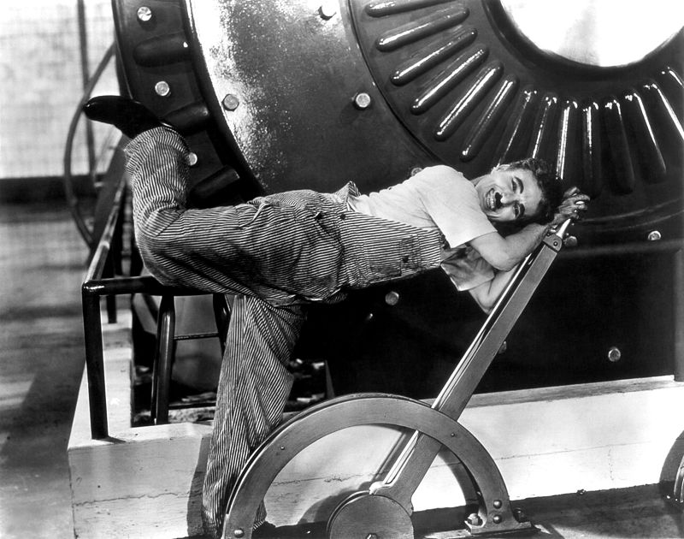
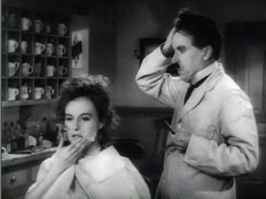
Film works and his roles
Charlie Chaplin’s most famous roles are:The Tramp and Jewish Barber

Slide 11
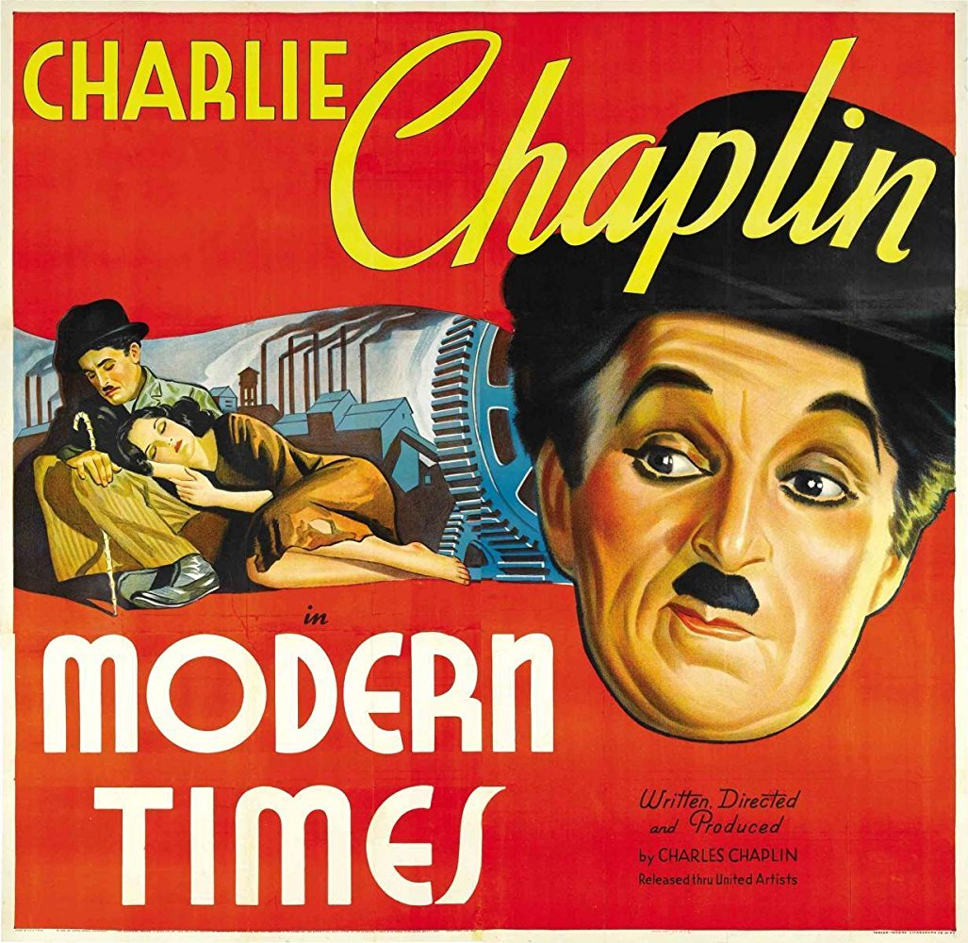
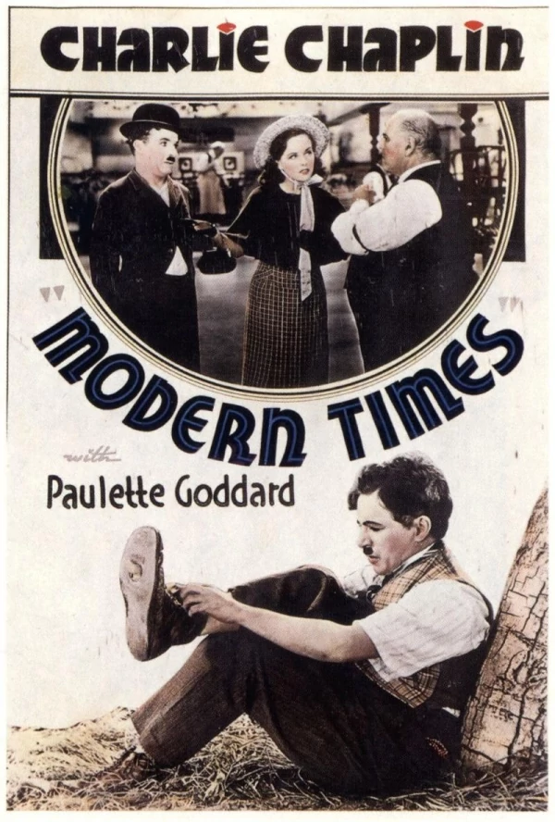
Modern Times
Modern Times portrays Chaplin in his Tramp persona as a factory worker employed on an assembly line There, he is subjected to such indignities as being force-fed by a malfunctioning "feeding machine" and an accelerating assembly line where he screws nuts at an ever-increasing rate onto pieces of machinery. He finally suffers a nervous breakdown and runs amok, throwing the factory into chaos. He is sent to a hospital. Following his recovery, the now unemployed factory worker is mistakenly arrested as an instigator in a Communist demonstration.

Slide 12
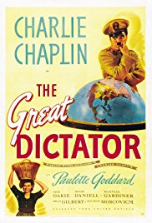
The Great Dictator
On the Western Front in 1918, a Jewish Private Charlie Chaplin fighting for the Central Powers nation of Tomainia valiantly saves the life of a wounded pilot, Commander Schultz ,who carries valuable documents that could secure a Tomainia victory. However, their plane crashes mid-flight, and the Private subsequently suffers memory loss. Upon being rescued, Schultz is informed that Tomania has officially surrendered to the, while the Private is carried off to a hospital.

Slide 13
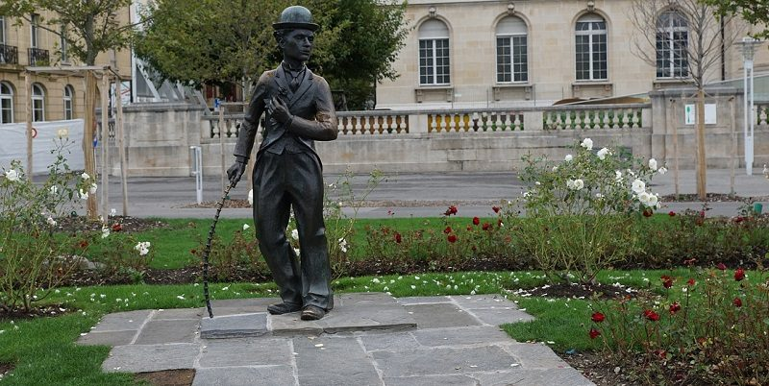
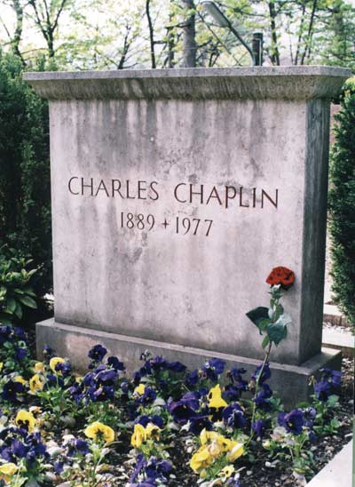
After the death of Charlie Chaplin
Although the famous actor has always dealt with sports, he did not smoke or drink, his health worsened rapidly at the end of the sixties, after completing the last Grofice film from Hong Kong. He died in a dream on Christmas 25.12.1977. in Vevey, Switzerland, and when he closed his eyes he was 88 years old. Even after his death, Chaplin failed to find eternal peace. His body, buried at the Corsier-sur-Vevey cemetery, was stolen by Polish emigrants in the night between April 1 and April 1978, seeking to extort 600,000 dollars from his family. They soon fell into the hands of the police, and the comedy body buried twenty kilometers from the cemetery was found by a farmer. Charlie was buried again in the same tomb, this time under thick concrete.

Slide 14
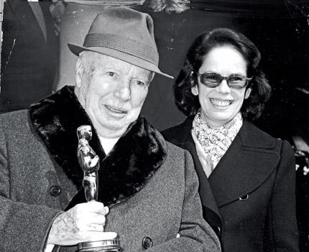
Last year of life Charlie Chaplin
Under the old days, he was playing music for his old films. The comer was later drawn to the lights of the Stage of the Stage, the King in New York, and the Countess of Hong Kong. Even while he was at the height of popularity in America, Charlie did not want to take American citizenship because he was constantly attacked by various political organizations that accused him of being a communist and a whirlwind. When he learned in 1952 that the then justice minister denied the visa to return to America, Chaplin vowed that he would never go there again. His home was found in a village a few miles away from the Swiss Montrua. The popular Riding Bowl in America came back only in 1972 to receive the Honorary Oscar for a special influence and development of 20th century film art.

Slide 15
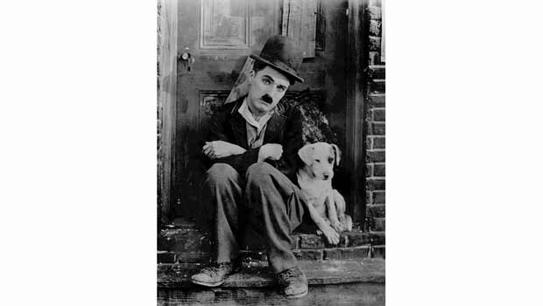
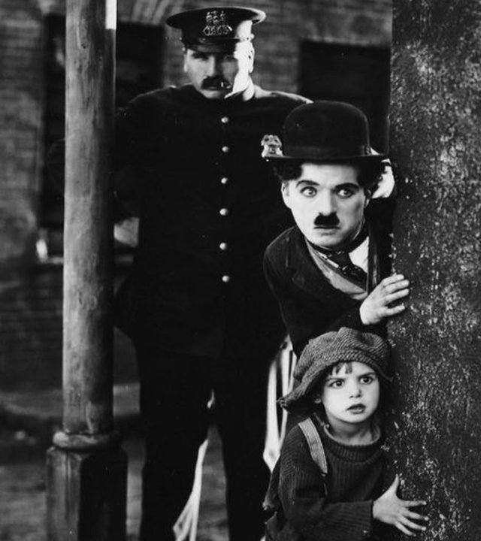
Charlie Chaplin left behind unforgettable works with his participation in film art

